Slide 1




Slide 2

ASME IDETC2023 Hackathon – Autodesk Problem
Automating Material Selection for Product Design
Lequn Chen
Contact: chen1470@e.ntu.edu.sg
Nanyang Technological University, Singapore
Notes:
Good afternoon, professors, and distinguished guests. My name is Lequn, and I am a PhD candidate from Nanyang Technological University. Today, I’m glad to present my paper, "Multimodal Sensor Fusion For Real-time Location-dependent Defect Detection In Laser-directed Energy Deposition"

Slide 3
01
Dataset Analysis
02
Feature Engineering
02
Dimensionality reduction
CONTENTS
03
ML Modelling
04
Results and Discussion
05
Future Works

Slide 4
1. Dataset Analysis
Assembly JSON file hierarchical structure
Keys: (['tree', 'root', 'occurrences', 'components', 'bodies', 'as_built_joints', 'contacts', 'holes', 'properties'])
Properties:
Assembly level information
['name', 'bounding_box', 'vertex_count', 'edge_count', 'face_count', 'loop_count', 'shell_count', 'body_count', 'area', 'volume', 'density', 'mass', 'center_of_mass', 'principal_axes', 'xyz_moments_of_inertia', 'surface_types', 'vertex_valence', 'design_type', 'likes_count', 'comments_count', 'views_count', 'products', 'categories', 'industries’])
Bodies:
Individual Component level information
{'name': 'Body7', 'type': 'BRepBody', 'png': 'e397626e-0608-11ec-a470-02052889e3af.png', 'smt': 'e397626e-0608-11ec-a470-02052889e3af.smt', 'step': 'e397626e-0608-11ec-a470-02052889e3af.step', 'obj': 'e397626e-0608-11ec-a470-02052889e3af.obj', 'physical_properties': {'center_of_mass': {'type': 'Point3D', 'x': 0.25315821192952176, 'y': 0.03333797923237883, 'z': 2.7849977545097624}, 'area': 19.067095914836415, 'volume': 1.128564254878852}, 'material_category': 'Plastic'}

Slide 5
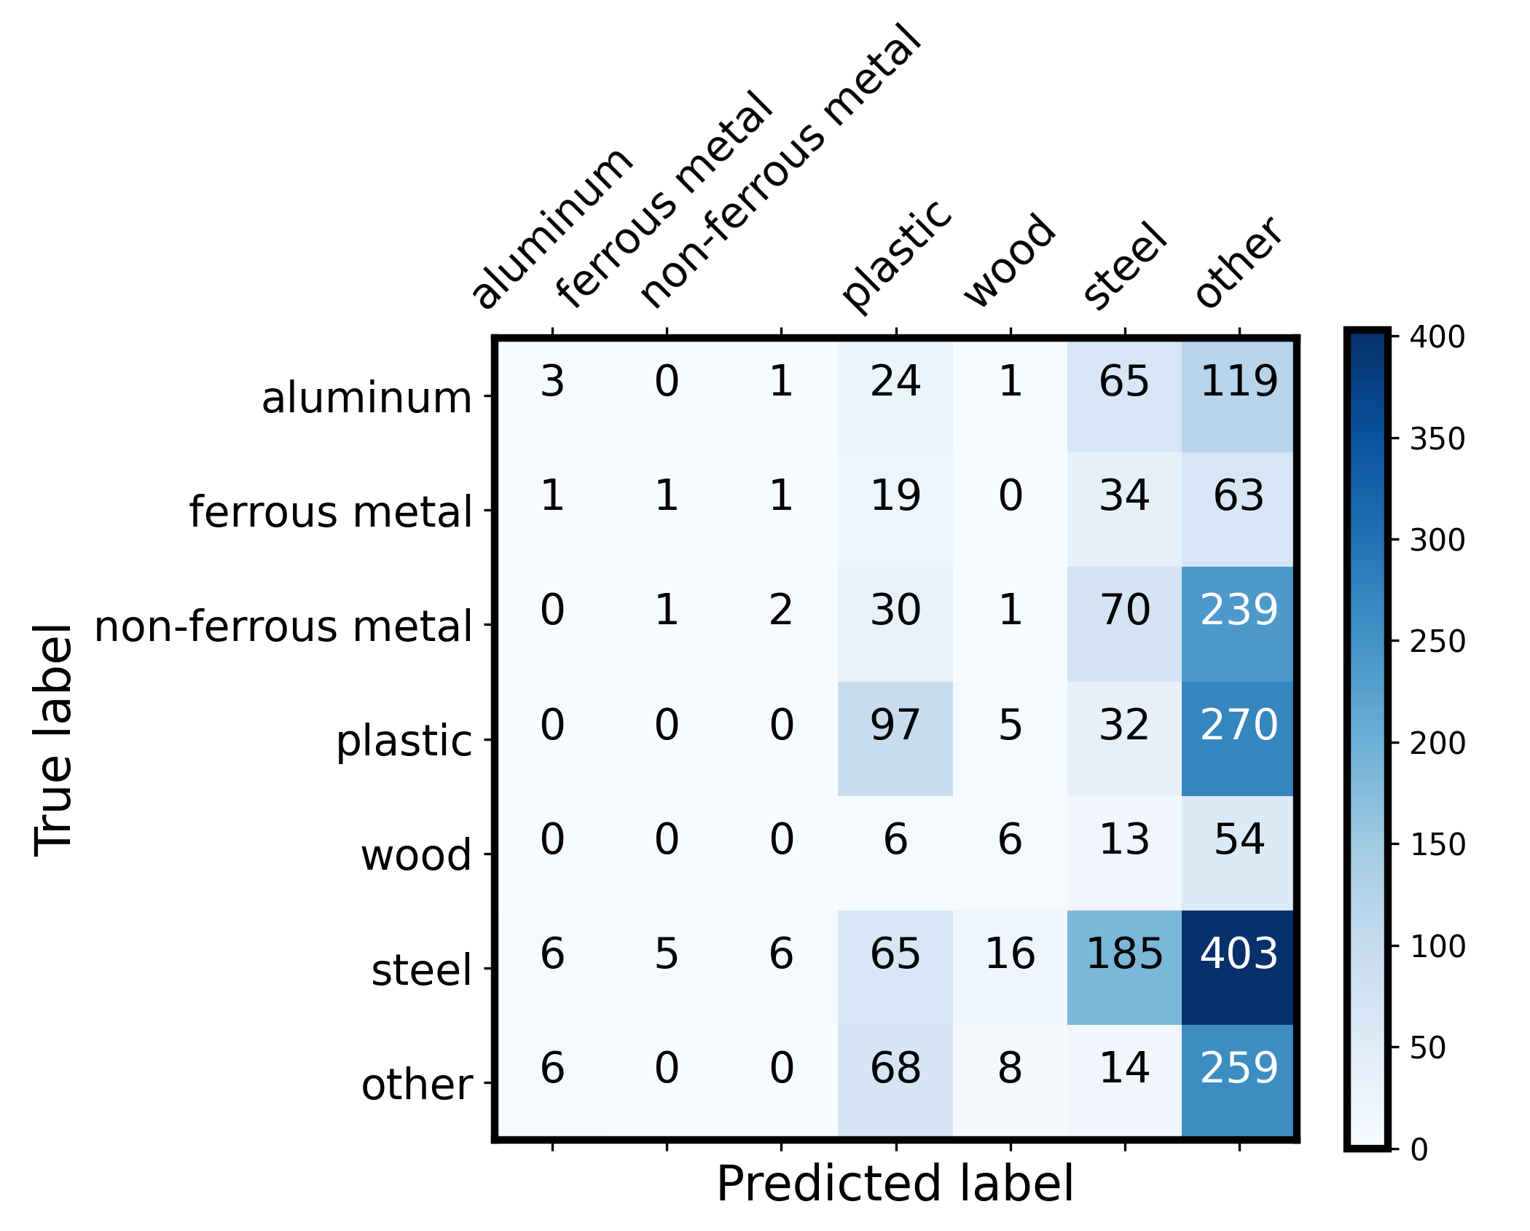
Baseline Model performance – GPT3.5 + only “name” in the prompt

Slide 6
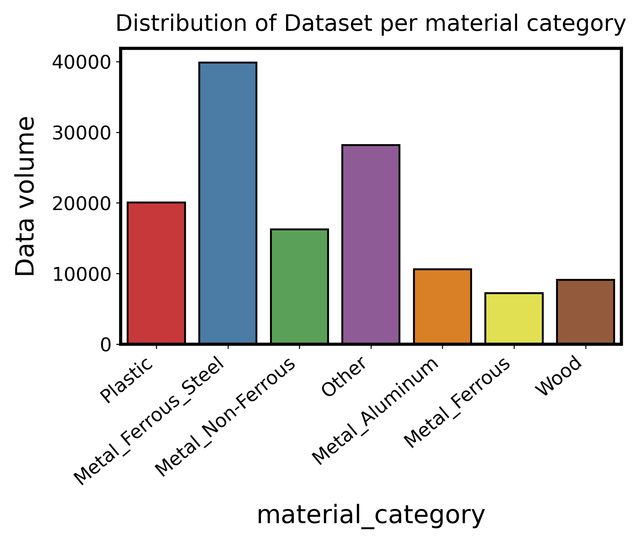
1. Dataset Analysis (Training set)
Notes:
Dataset is imbalanced
Need to consider this factor during the modelling process.

Slide 7
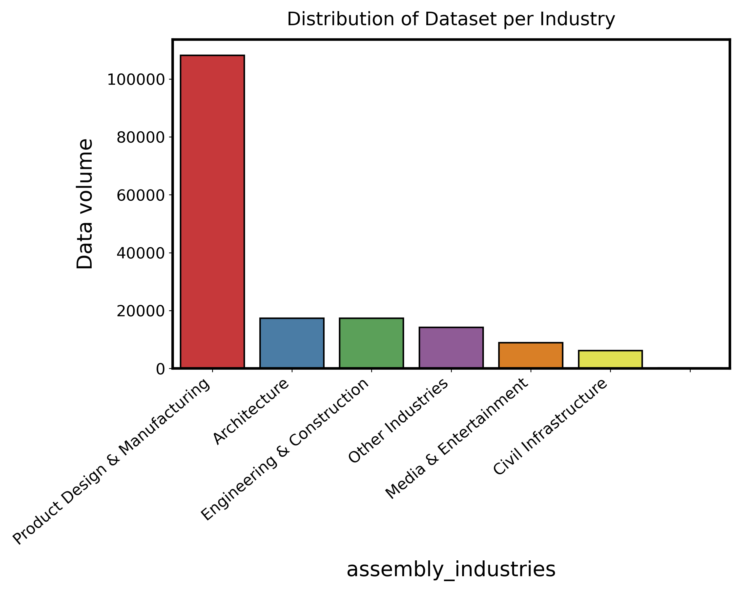
1. Dataset Analysis (Training set)
Notes:
Categorical Data.
A part could belong to multiple industries.
Multi-label Binarization for multiple categorical features

Slide 8
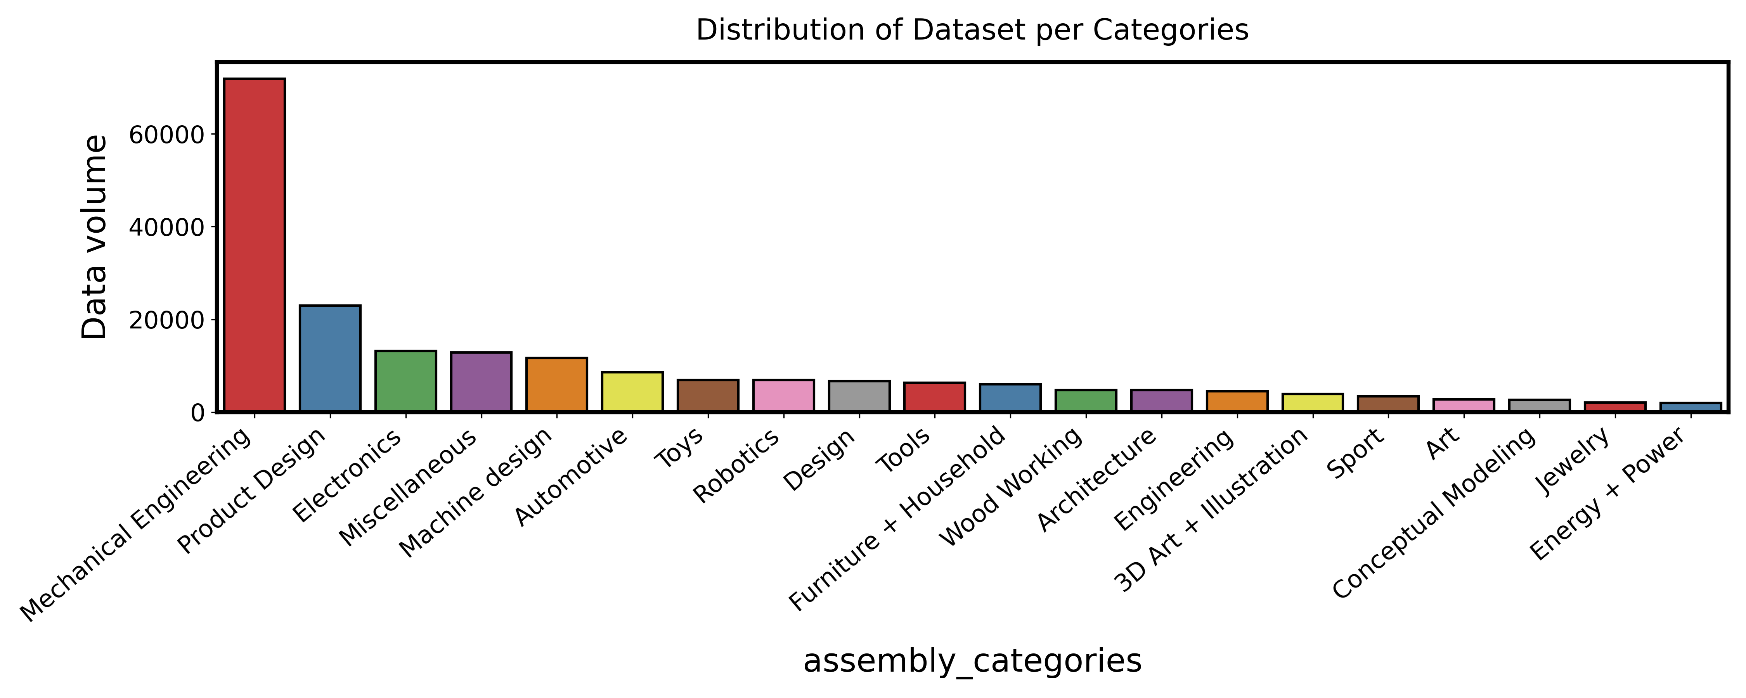
1. Dataset Analysis (Training set)
Notes:
Categorical Data.
A part could belong to multiple categories.
Multi-label Binarization for multiple categorical features

Slide 9
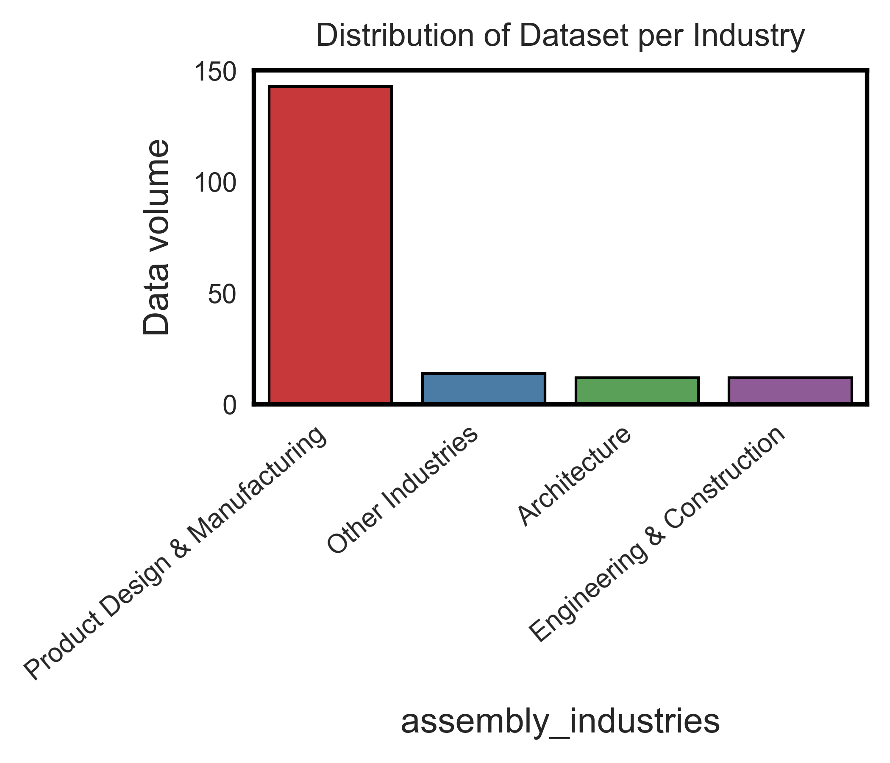
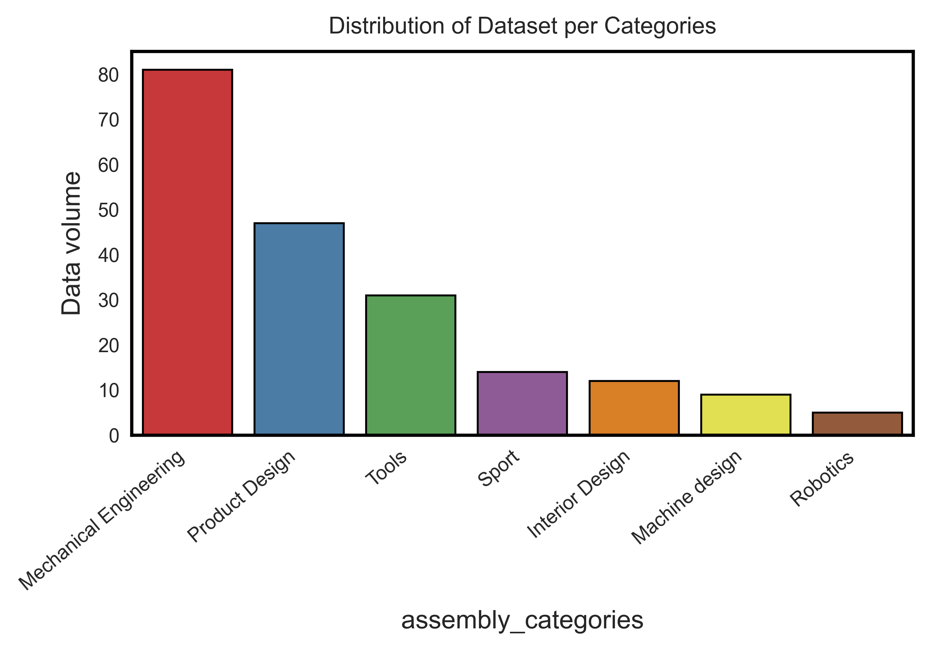
1. Dataset Analysis (Test set)
Test set has fewer industries, categories.
Obviously, it is not the same distribution as in the training set. This means there could be a distribution shift, so we need to make our ML as robust as possible.

Slide 10
2. Feature Engineering
tree and root: represent the hierarchical structure of the design. The depth of the tree (how many levels of hierarchy are there) might be indicative of the complexity of the assembly.
Potential feature: depth of the tree.
Occurrences:
Give instances of components. These can show how many times a component is repeated in a design.
Extracted: number of unique components, total number of components (including repetitions).
Components:
sub-assemblies
Potential features: number of components, average number of bodies per component.
joints:
define the relative position and orientation between occurrences.
Potential features: number of joints, distribution of different types of joints (e.g., ball, revolute, slider), average degrees of freedom per joint.
Notes:
tree and root:
These seem to represent the hierarchical structure of the design. While the exact structure might not be directly useful as a feature, the depth of the tree (how many levels of hierarchy are there) might be indicative of the complexity of the assembly.
Potential feature: depth of the tree.
occurrences:
The occurrences give instances of components. These can show how many times a component is repeated in a design.
Potential features: number of unique components, total number of components (including repetitions).
components:
Components form sub-assemblies, so they indicate parts that go together.
Potential features: number of components, average number of bodies per component.
bodies:
We have already extracted features from bodies in the previous function.
joints:
Joints define the relative position and orientation between occurrences.
Potential features: number of joints, distribution of different types of joints (e.g., hinge, slider), average degrees of freedom per joint.
as_built_joints:
These joints maintain their position and don't get transformed.
Potential features: number of as_built_joints.
contacts:
Faces in contact can show which bodies are interacting with each other.
Potential features: number of contacts, distribution of bodies involved in contacts.
holes:
Holes in the assembly can be crucial for certain materials (e.g., metals might be preferred where there are holes for screws).
Potential features: number of holes, distribution of hole types (e.g., through-hole, blind hole), average size of holes, distribution of hole sizes.
properties:
We have already extracted features from properties in the previous function.

Slide 11
2. Feature Engineering
as_built_joints: joints maintain their position and don't get transformed
Potential features: number of as_built_joints.
Contacts:
Faces in contact can show which bodies are interacting with each other
Potential features: number of contacts, distribution of bodies involved in contacts.
Holes:
Holes in the assembly can be crucial for certain materials (e.g., metals might be preferred where there are holes for screws).
Features extracted: (1) number of holes in each body, (2) distribution of hole types (e.g., through-hole, blind hole), (3) average size of holes, distribution of hole sizes. (4) average, maximum, and minimum lengths of holes across the entire assembly. (5) Distribution of holes across bodies: indicate which bodies have the highest number of holes and potentially indicate their significance in the assembly.
Notes:
tree and root:
These seem to represent the hierarchical structure of the design. While the exact structure might not be directly useful as a feature, the depth of the tree (how many levels of hierarchy are there) might be indicative of the complexity of the assembly.
Potential feature: depth of the tree.
occurrences:
The occurrences give instances of components. These can show how many times a component is repeated in a design.
Potential features: number of unique components, total number of components (including repetitions).
components:
Components form sub-assemblies, so they indicate parts that go together.
Potential features: number of components, average number of bodies per component.
bodies:
We have already extracted features from bodies in the previous function.
joints:
Joints define the relative position and orientation between occurrences.
Potential features: number of joints, distribution of different types of joints (e.g., hinge, slider), average degrees of freedom per joint.
as_built_joints:
These joints maintain their position and don't get transformed.
Potential features: number of as_built_joints.
contacts:
Faces in contact can show which bodies are interacting with each other.
Potential features: number of contacts, distribution of bodies involved in contacts.
holes:
Holes in the assembly can be crucial for certain materials (e.g., metals might be preferred where there are holes for screws).
Potential features: number of holes, distribution of hole types (e.g., through-hole, blind hole), average size of holes, distribution of hole sizes.
properties:
We have already extracted features from properties in the previous function.

Slide 12
2. Feature Engineering
Physical Properties (global feature): Area, mass, density, and moments of inertia (xx, yy, zz, xy, yz, xz); Different materials will have distinct densities and mass distributions.
Geometry Information:
- Bounding Box Dimensions
- Vertex count, Edge count, Face count, Loop count, Shell count, Body count: These counts can give an idea about the complexity of the geometry.
- Surface Types: The types of surfaces (e.g., cylindrical, planar, toroidal) and their counts can provide insights into the manufacturing processes suitable for the part, which in turn might hint at the material.
Surface Types:
provide information about the different types of geometric surfaces that exist in the assembly.
Surface types can relate to the Manufacturing processes, which indirectly related to material. Surfaces such as planes might be used in structural parts of an assembly, demanding materials with higher strength. On the other hand, cylindrical or toroidal surfaces might indicate rotational parts, hinting at the need for materials with low friction properties.
Notes:
A breakdown of potentially useful information:
1. Physical Properties: The physical properties of the body, such as mass, density, and moments of inertia, can be informative. Different materials will have distinct densities and mass distributions.
- Area
- Volume
- Density
- Mass
- Moments of Inertia (xx, yy, zz, xy, yz, xz)
2. **Geometry Information**: The geometric complexity and shape of a part can sometimes hint at the material. For instance, intricate geometries might be made of materials that are easy to mold or machine.
- Bounding Box Dimensions: The difference between the max and min points on each axis can give the size in x, y, and z directions.
- Vertex count, Edge count, Face count, Loop count, Shell count, Body count: These counts can give an idea about the complexity of the geometry.
- Surface Types: The types of surfaces (e.g., cylindrical, planar, toroidal) and their counts can provide insights into the manufacturing processes suitable for the part, which in turn might hint at the material.
3. **Design Information**:
- Design Type: Whether the design is parametric or some other type might influence material choice.
4. **Engagement Metrics**: While these metrics (likes, comments, views) might not directly influence the material, they might correlate with certain material choices if popular designs tend to use specific materials.

Slide 13
2. Feature Engineering
Categories and Industries (assembly level feature): The industry and category the design is intended for can be a strong hint. For instance, designs in the "Aerospace" category might prefer lightweight and strong materials like titanium or composite materials.
Vertex Valence: number of edges incident to a vertex
High Valence:many components or features are connected at that point, potential require more durable and robust material
Distribution: A higher average vertex valence might suggest a densely interconnected assembly.
Derived Features: Some features can be derived from the existing data to enhance its expressiveness. For instance:
- Aspect Ratios: Derived from the bounding box dimensions, they can indicate if a part is elongated, flat, or almost cubic, which might influence material choice.
- Complexity Metrics: Ratios like vertex-to-edge count, face-to-loop count, can be indicative of the overall complexity of the design.
- Volume fraction: Body volume divided by the assembly volume. Large volume fraction could indicate primary component and might be made of a material suitable for bearing loads or stresses. Conversely, small volume fractions might represent accessory or supplementary components.
Notes:
5. **Categories and Industries**: The industry and category the design is intended for can be a strong hint. For instance, designs in the "Aerospace" industry might prefer lightweight and strong materials like titanium or composite materials.
6. **Derived Features**: Some features can be derived from the existing data to enhance its expressiveness. For instance:
- **Aspect Ratios**: Derived from the bounding box dimensions, they can indicate if a part is elongated, flat, or almost cubic, which might influence material choice.
- **Complexity Metrics**: Ratios like vertex-to-edge count, face-to-loop count, etc., can be indicative of the overall complexity of the design.
- The volume fraction can indicate the significance or size of a component relative to the entire assembly. If a component occupies a significant portion of the assembly, it may hint that the component is primary and might be made of a material suitable for bearing loads or stresses. Conversely, small volume fractions might represent accessory or supplementary components.
7. **Components and Hierarchical Structure**: The relationships between components can be meaningful. If certain sub-components are made of a specific material, it might influence the material choice of the main body. However, this requires a more complex modeling approach to take hierarchy into account.

Slide 14
2. Feature Engineering
Derived feature:
Center of mass distance: the Euclidean distance between the body's center of mass (COM) and the assembly's COM. → how the material is distributed within the assembly; gives an indication of how central or peripheral a body is within the assembly.
Online Metrics: While these metrics (likes, comments, views) might not directly influence the material, they might correlate with certain material choices (popularity) if popular designs tend to use specific materials.
Components and Hierarchical Structure (future work): The relationships between components can be meaningful. If certain sub-components are made of a specific material, it might influence the material choice of the main body. However, this requires a more complex modeling approach to take hierarchy into account. → potentially need to use knowledge graph to model the relationship
Notes:
5. **Categories and Industries**: The industry and category the design is intended for can be a strong hint. For instance, designs in the "Aerospace" industry might prefer lightweight and strong materials like titanium or composite materials.
6. **Derived Features**: Some features can be derived from the existing data to enhance its expressiveness. For instance:
- **Aspect Ratios**: Derived from the bounding box dimensions, they can indicate if a part is elongated, flat, or almost cubic, which might influence material choice.
- **Complexity Metrics**: Ratios like vertex-to-edge count, face-to-loop count, etc., can be indicative of the overall complexity of the design.
- The volume fraction can indicate the significance or size of a component relative to the entire assembly. If a component occupies a significant portion of the assembly, it may hint that the component is primary and might be made of a material suitable for bearing loads or stresses. Conversely, small volume fractions might represent accessory or supplementary components.
7. **Components and Hierarchical Structure**: The relationships between components can be meaningful. If certain sub-components are made of a specific material, it might influence the material choice of the main body. However, this requires a more complex modeling approach to take hierarchy into account.

Slide 15
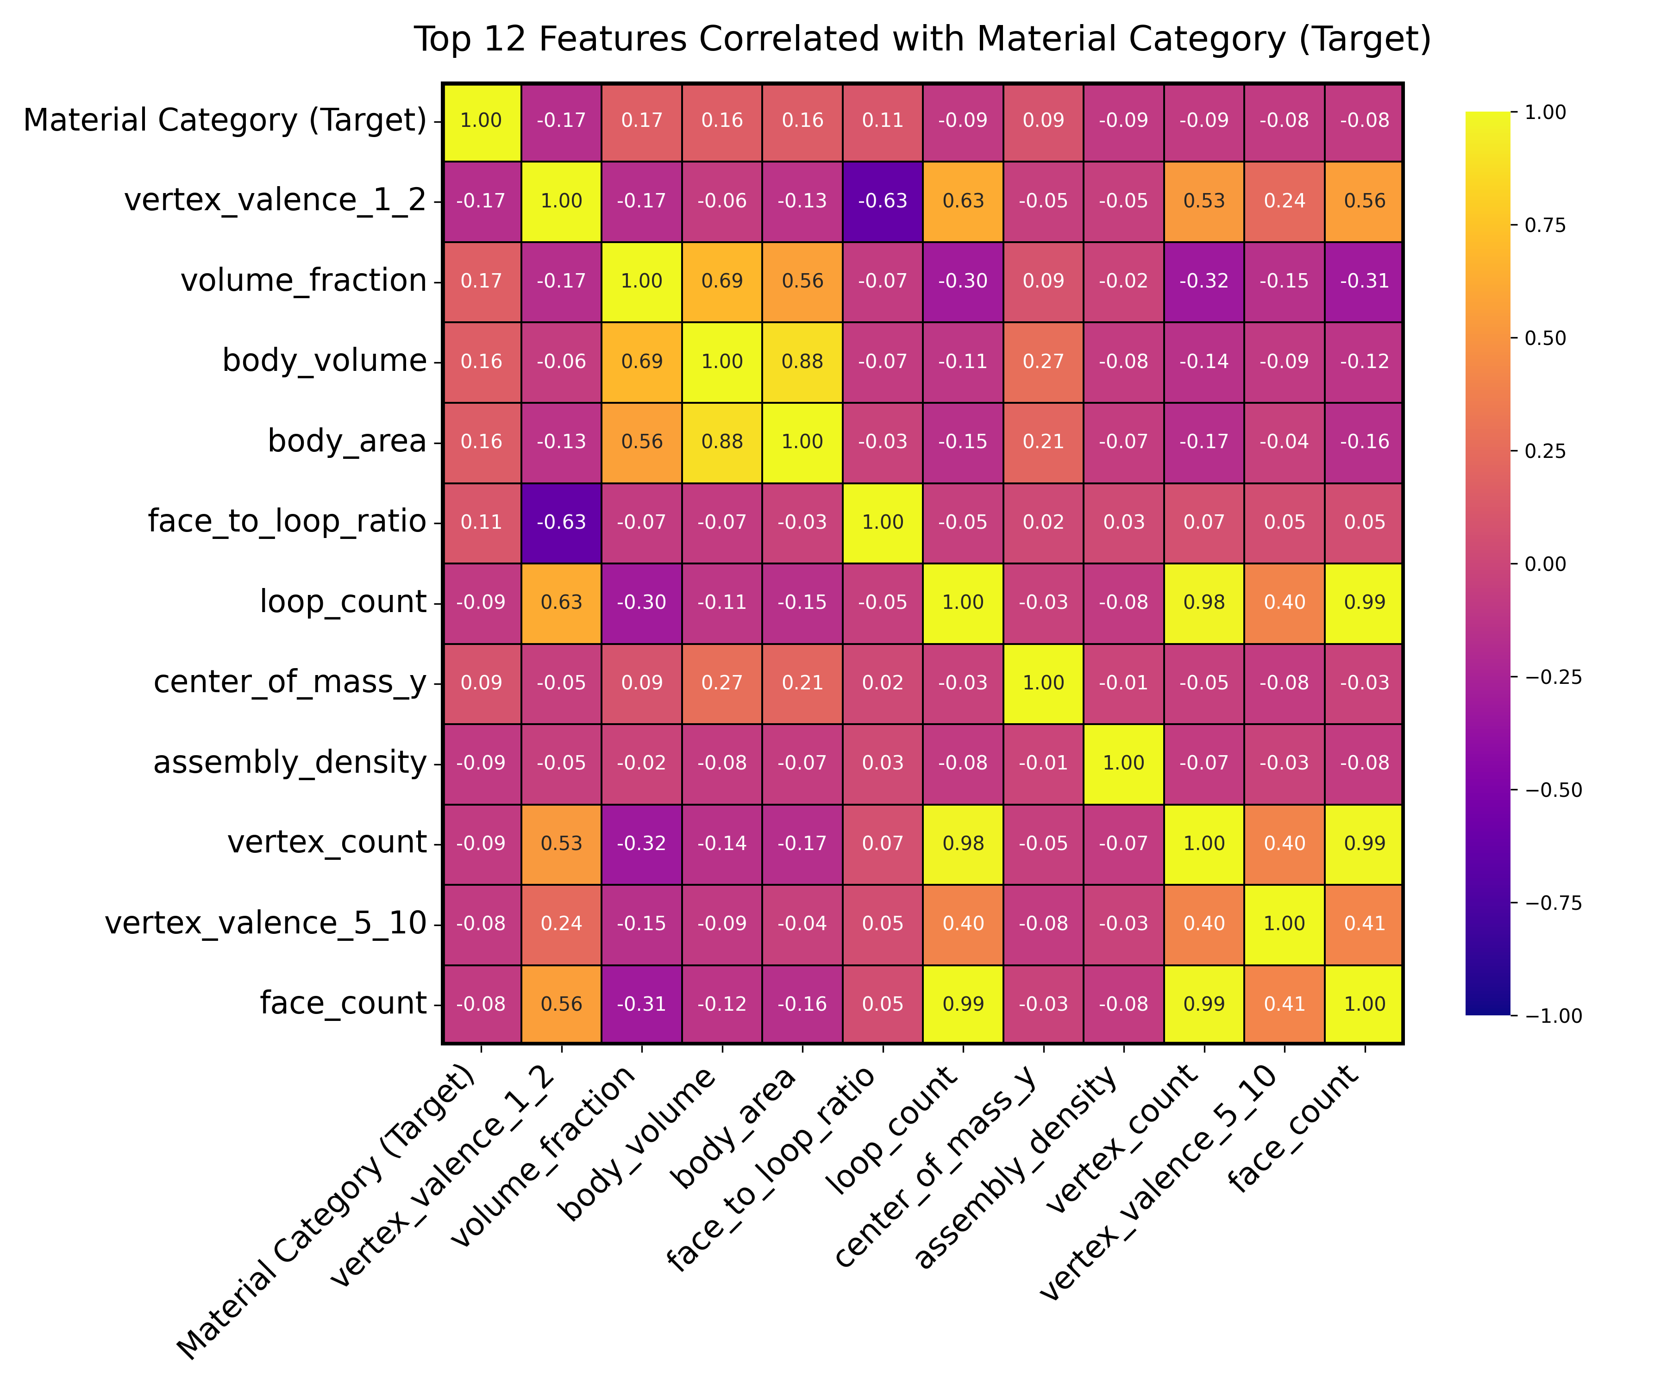
2. Feature Selection – Spearman's Rank Correlation matrix
The relationship between variables might not be strictly linear, Spearman’s matrix is chosen to evaluate the feature monotonic relationships
Multicollinearity: highly correlated independent variables can lead to multicollinearity, which might make the model unstable. → need to identify
Feature Importance: By looking at the correlation of each feature with the target variable, we can get the importance or influence of each feature on the target.
Notes:
Top Correlated Features with Target: Visualize only the top N features that have the highest absolute correlation with the target variable. This focuses on the most influential features.
Pearson measures the strength and direction of the linear relationship between two variables.
Spearman measures the strength and direction of the monotonic relationship between two variables.
Hierarchical Clustering Heatmap: This approach groups correlated features together in a heatmap. By clustering features that are similar, you can more easily digest the information.
Pairwise Scatter Plots for Selected Features: For features that seem particularly interesting or unexpected, plot them pairwise with the target variable or other features. This provides a more detailed view of relationships.
Dimensionality Reduction: Techniques like PCA (Principal Component Analysis) can be used to reduce the dimensionality of your data. This won't directly help with correlation visualization, but it can simplify your dataset and capture most of the variance in fewer principal components. You can then visualize these principal components.

Slide 16
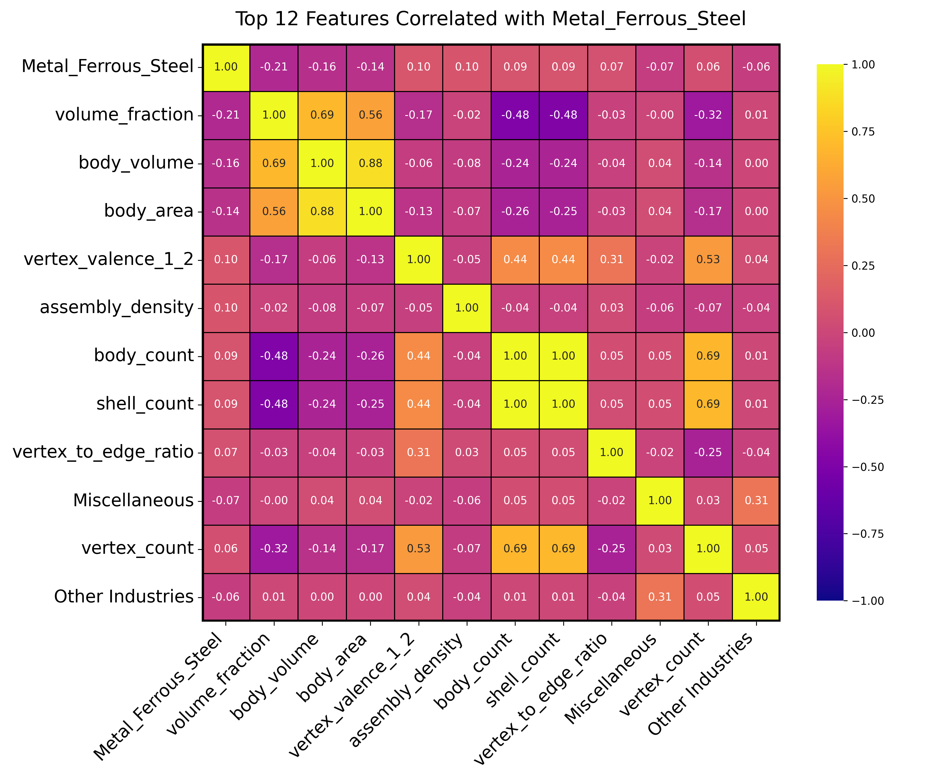
2. Feature Selection – Spearman's Rank Correlation matrix
Notes:
Top Correlated Features with Target: Visualize only the top N features that have the highest absolute correlation with the target variable. This focuses on the most influential features.
Pearson measures the strength and direction of the linear relationship between two variables.
Spearman measures the strength and direction of the monotonic relationship between two variables.
Hierarchical Clustering Heatmap: This approach groups correlated features together in a heatmap. By clustering features that are similar, you can more easily digest the information.
Pairwise Scatter Plots for Selected Features: For features that seem particularly interesting or unexpected, plot them pairwise with the target variable or other features. This provides a more detailed view of relationships.
Dimensionality Reduction: Techniques like PCA (Principal Component Analysis) can be used to reduce the dimensionality of your data. This won't directly help with correlation visualization, but it can simplify your dataset and capture most of the variance in fewer principal components. You can then visualize these principal components.

Slide 17
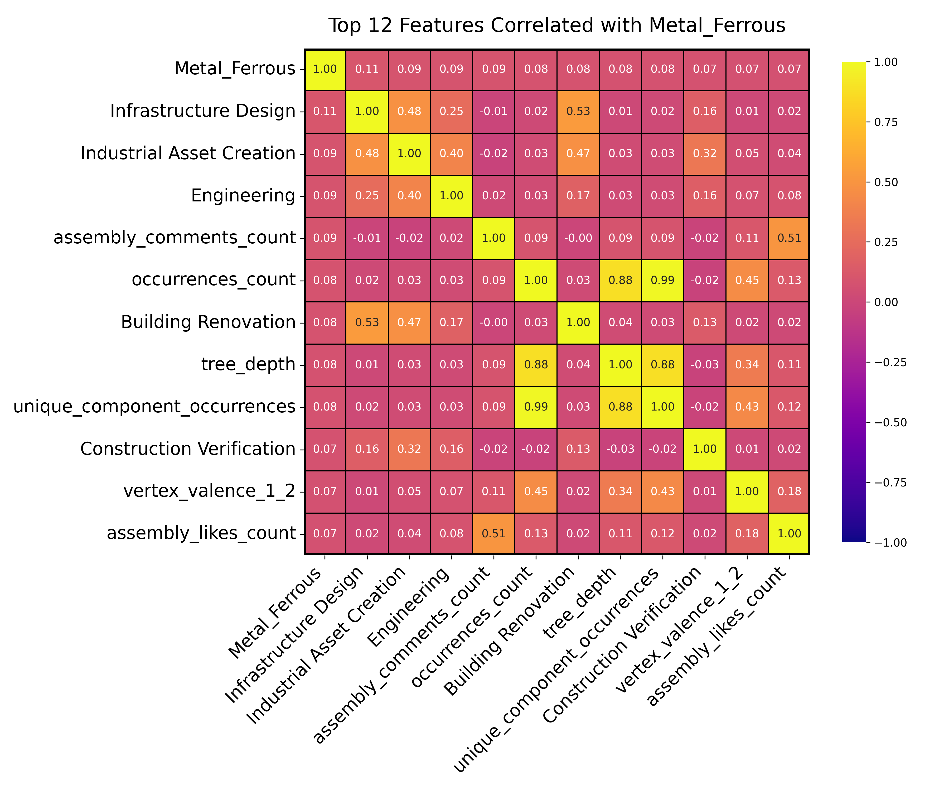
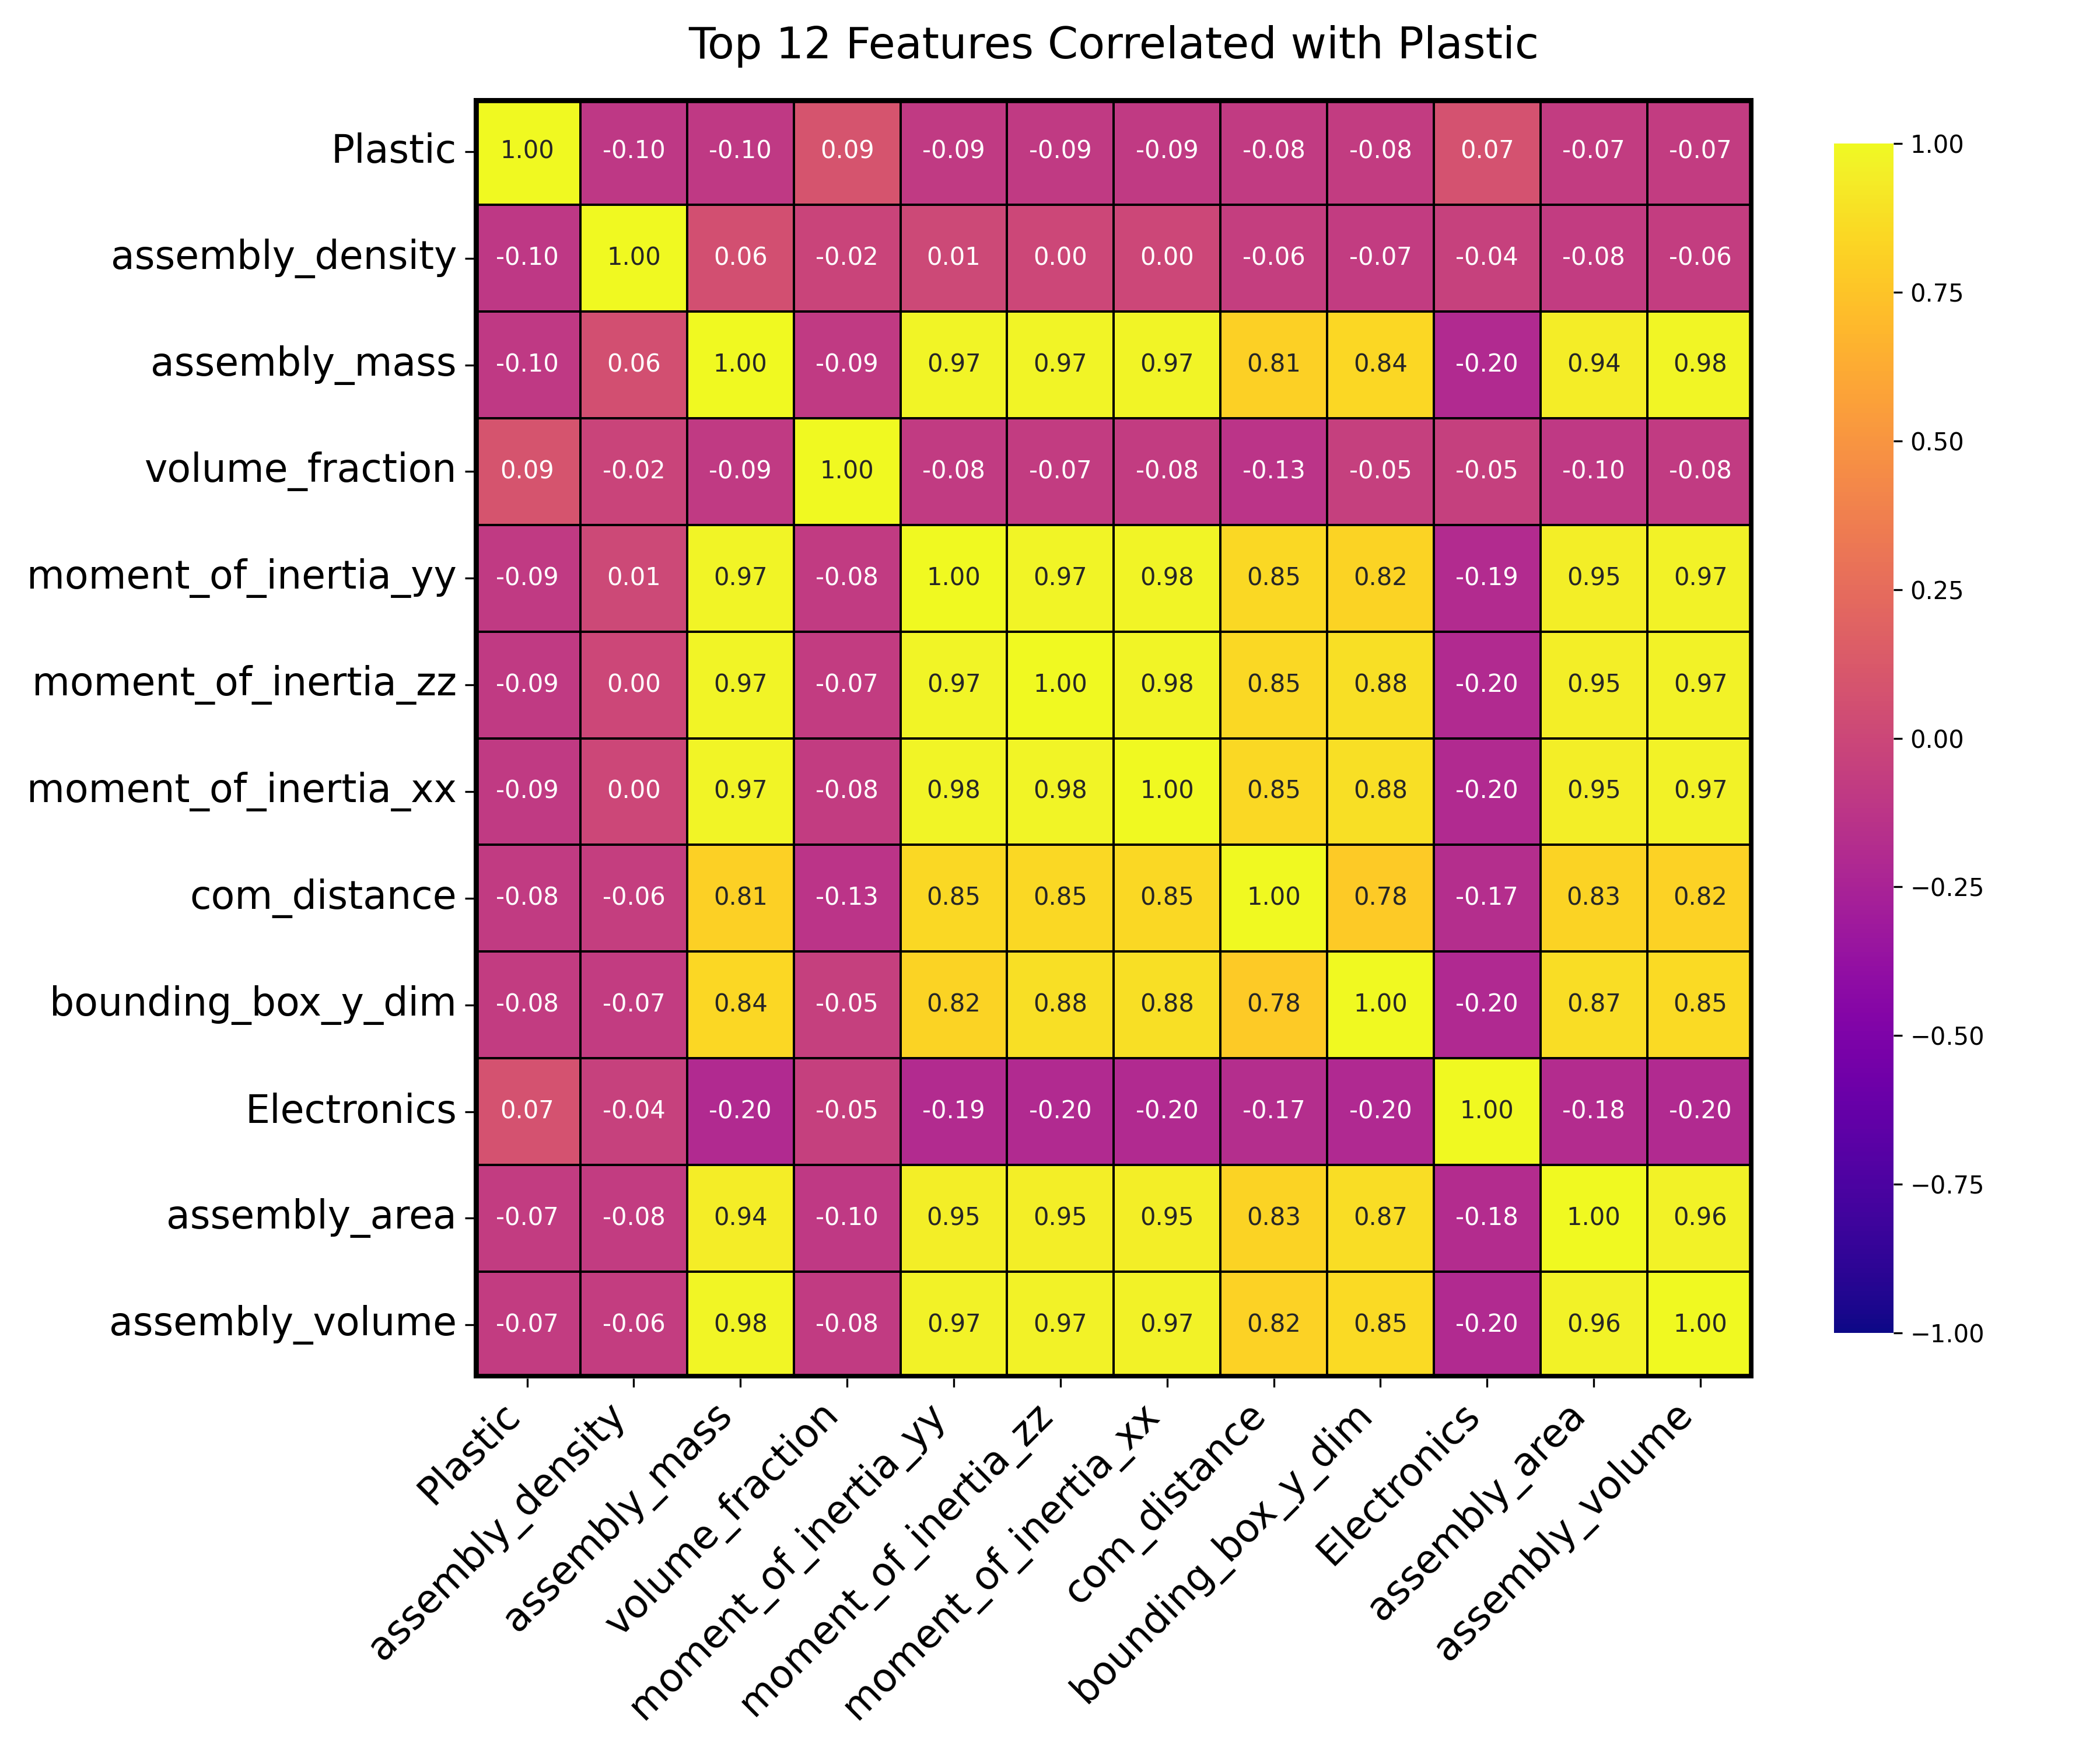
2. Feature Selection – Spearman's Rank Correlation matrix with individual material category

Slide 18
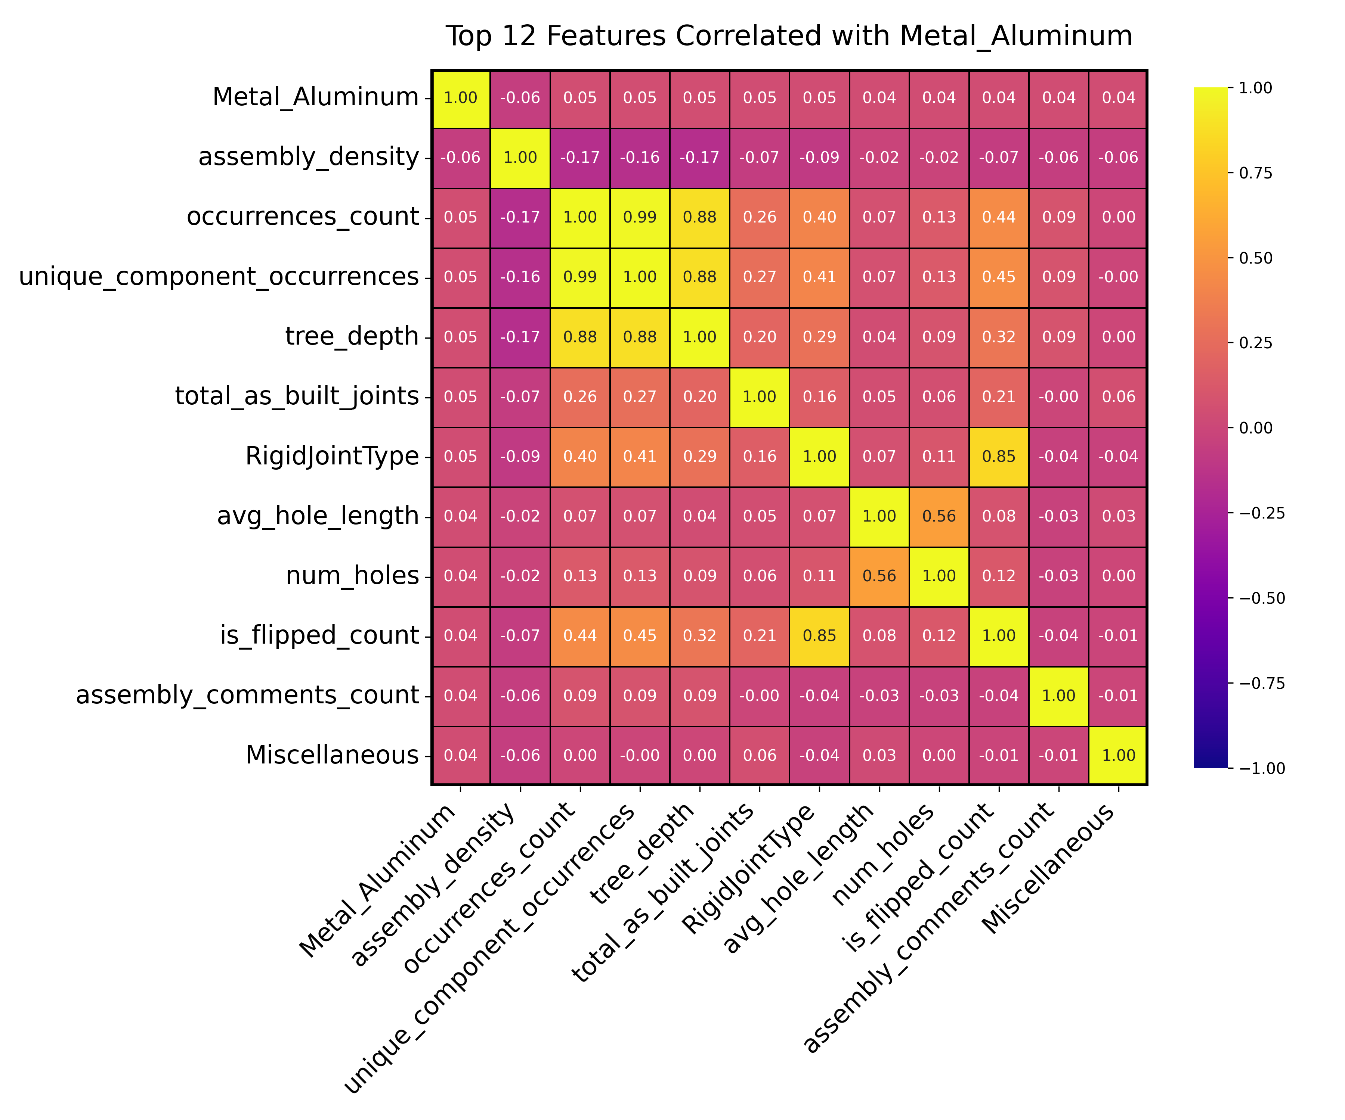
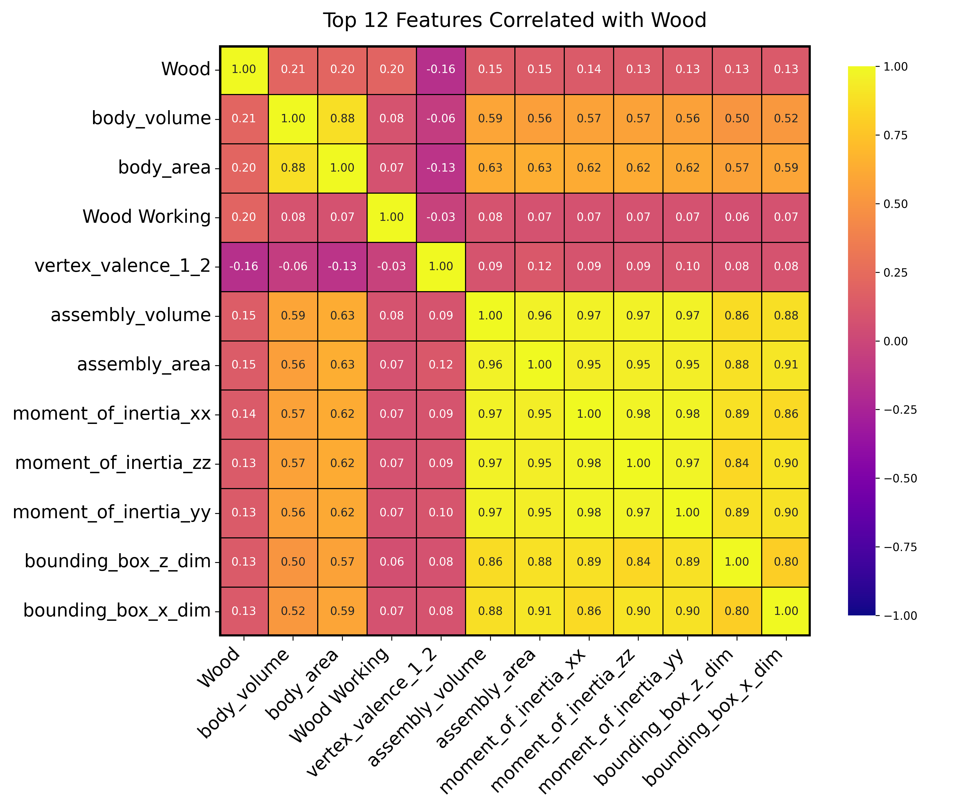
2. Feature Engineering – Spearman's Rank Correlation matrix with individual material category

Slide 19
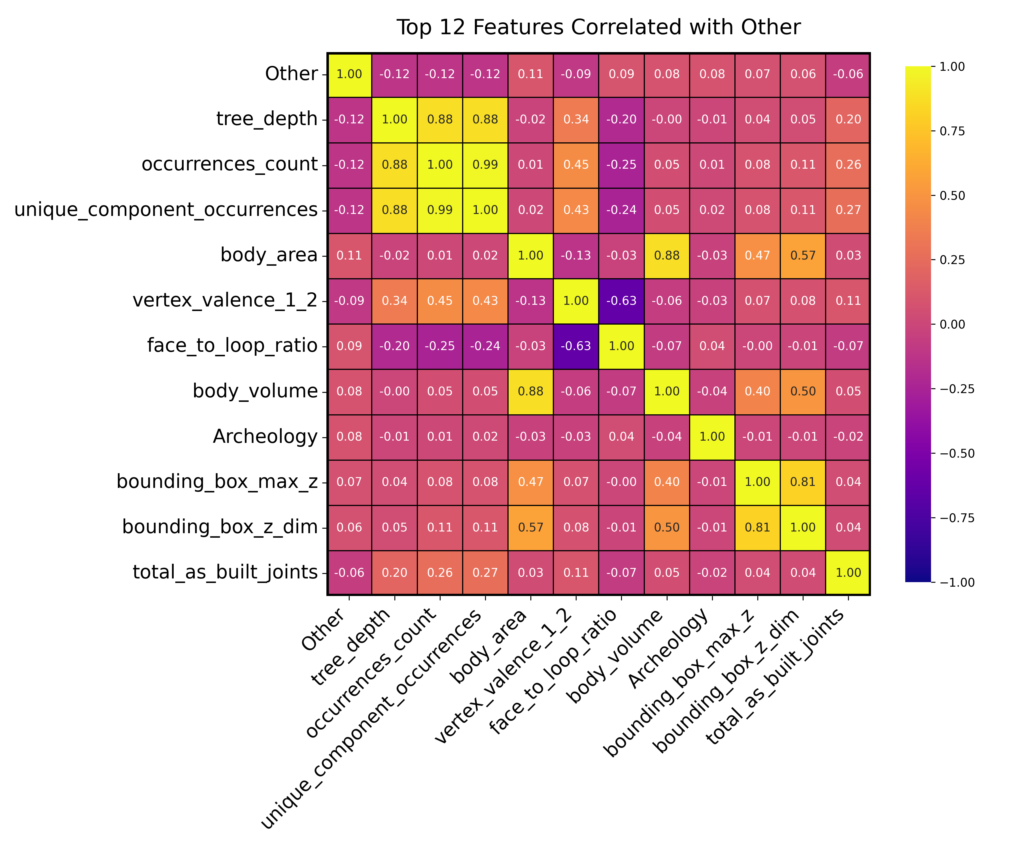
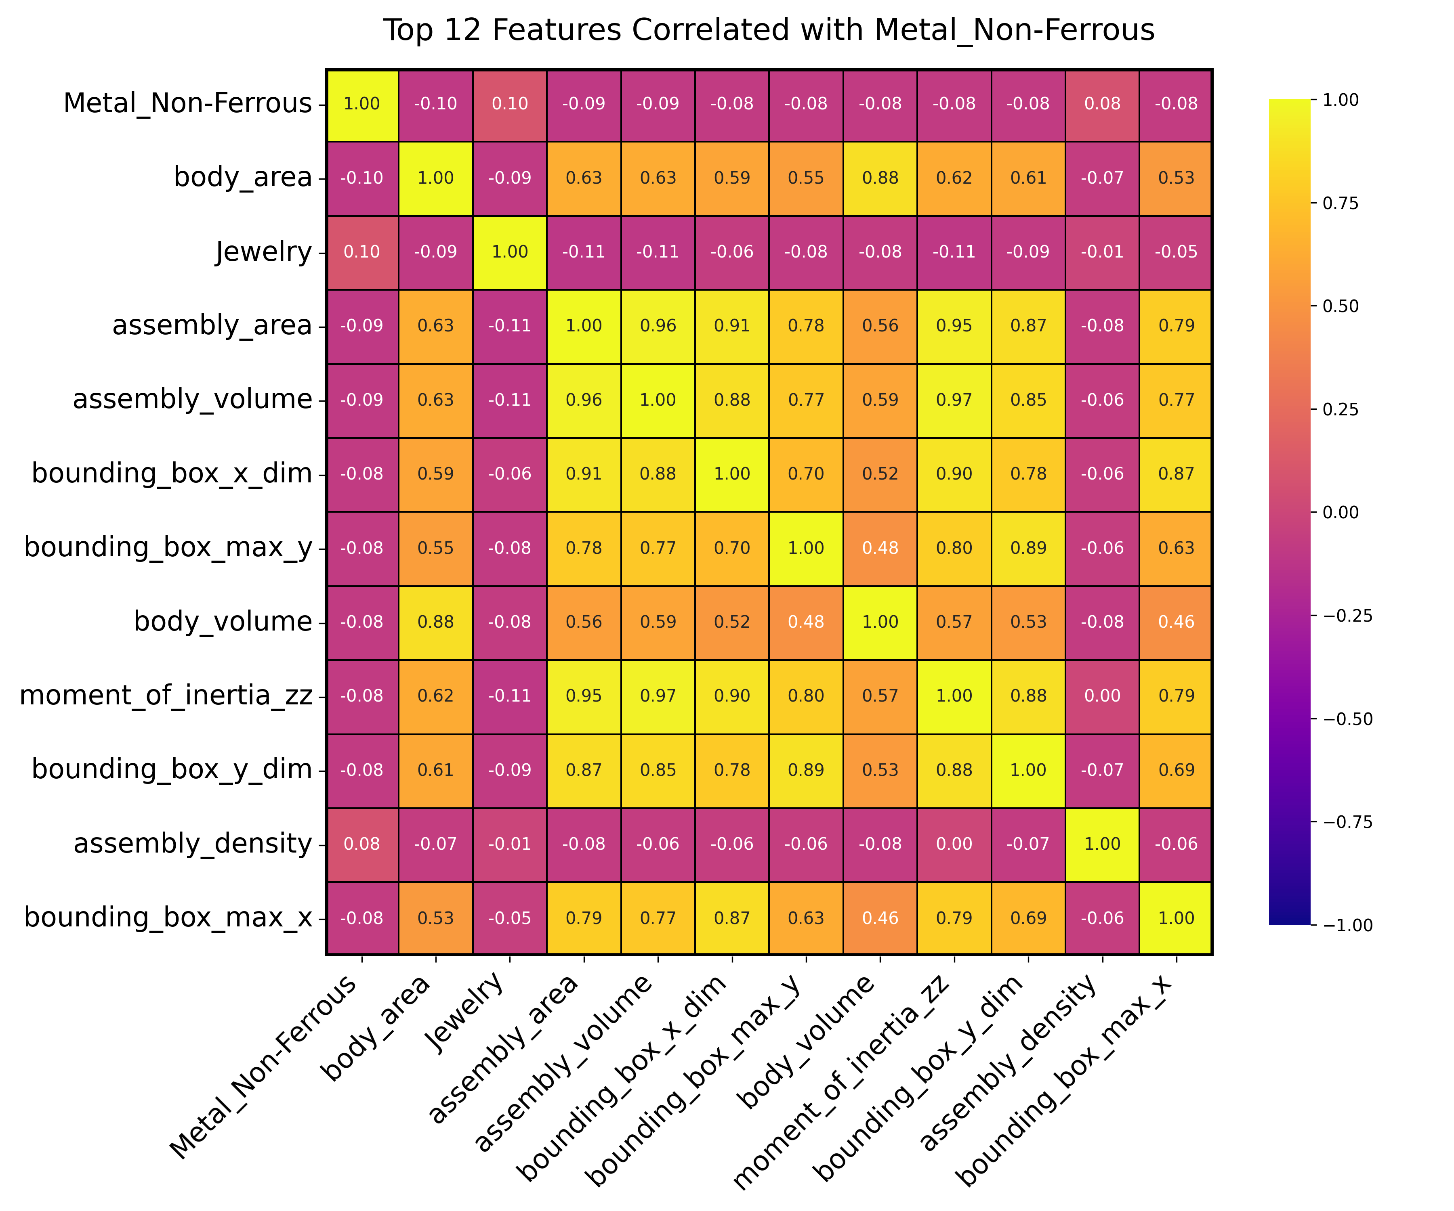
2. Feature Engineering – Spearman's Rank Correlation matrix with individual material category

Slide 20
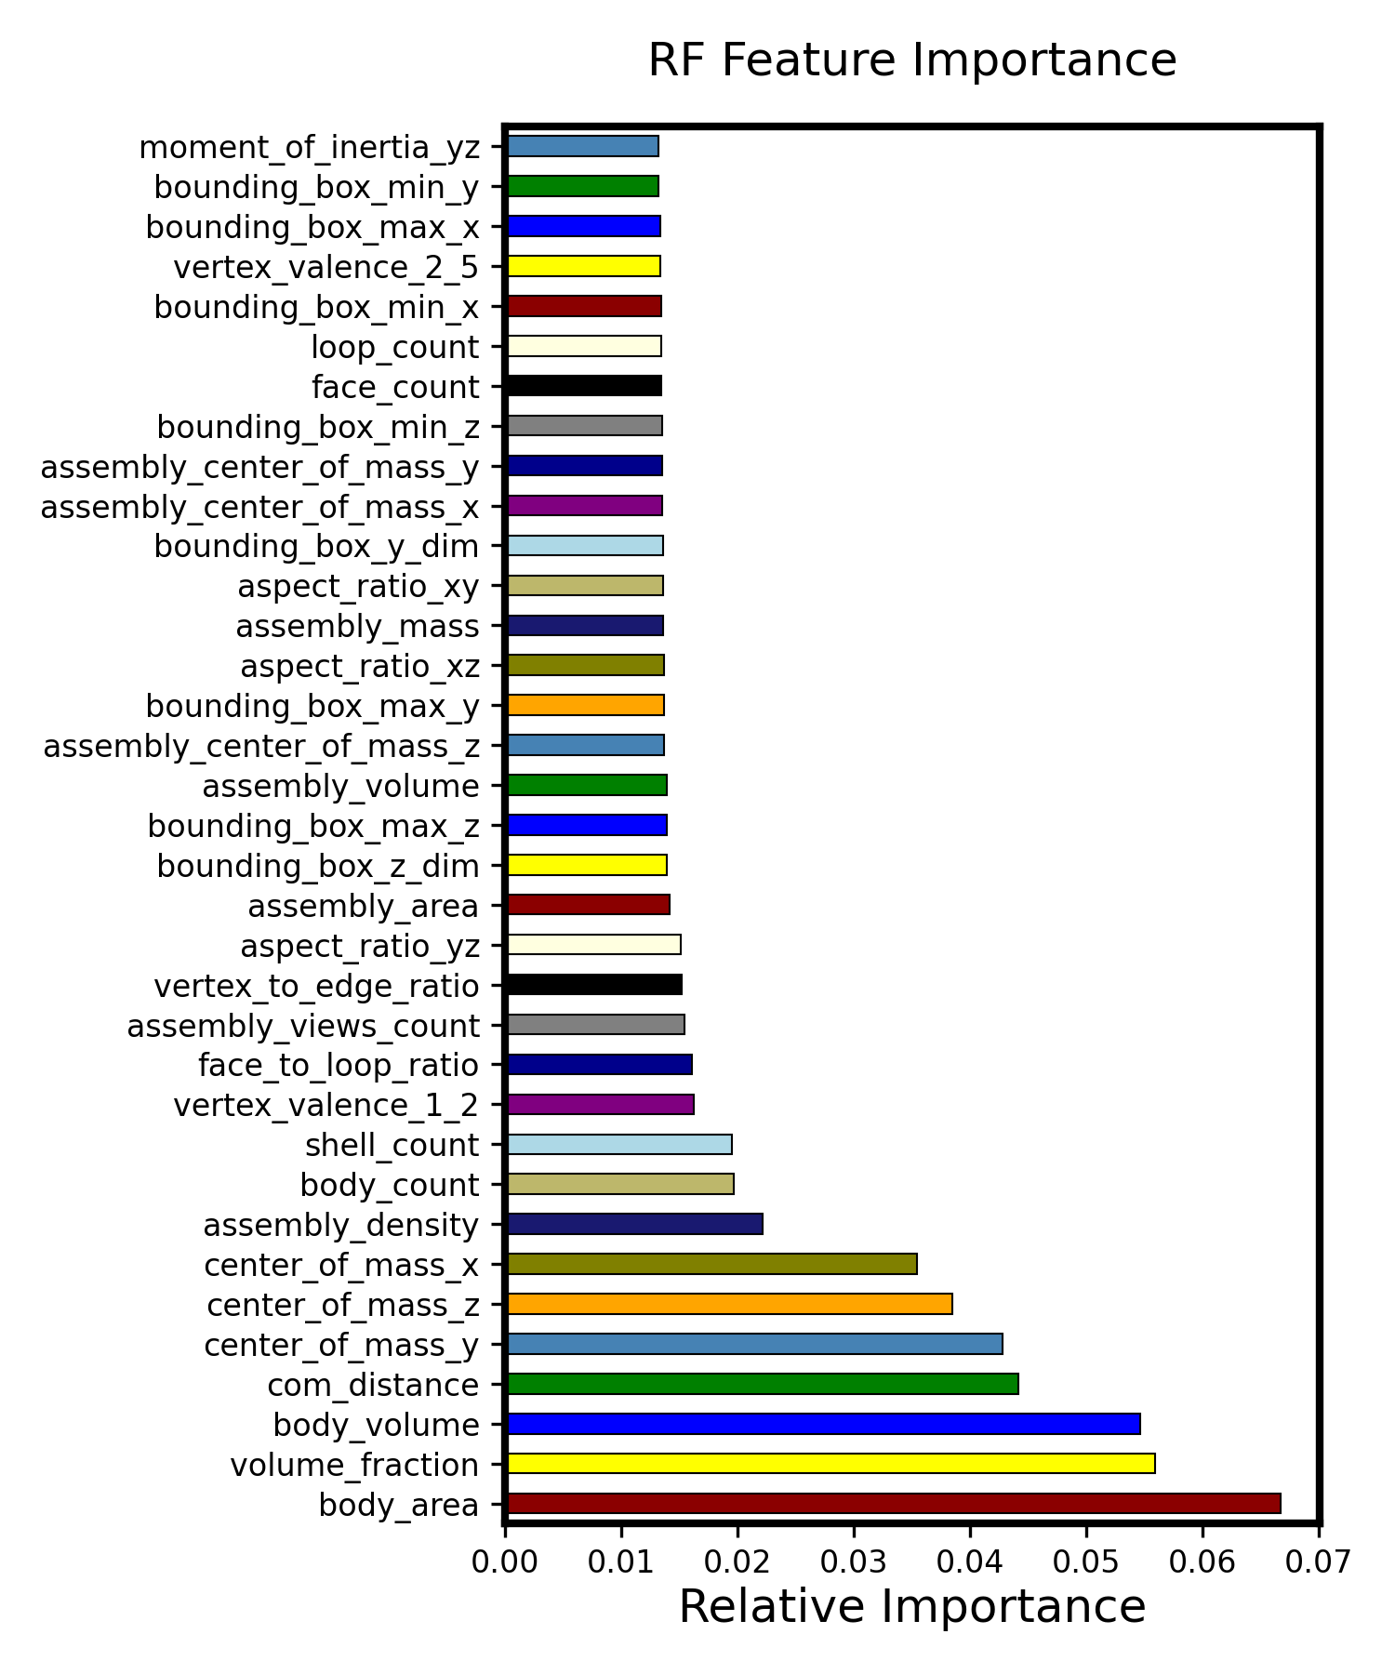
2. Feature Engineering – RF feature importance ranking
The features that are most influential in making predictions.
The highest importance in our case is around 0.065, which is considered low.
It means even a small importance score can be significant.
Features are selected from the correlation analysis and feature importance analysis
Notes:
Geometric Features Dominate: The top features are primarily geometric (body_area, volume_fraction, body_volume, center_of_mass coordinates, etc.). This indicates that the geometry of the assembly or part plays a significant role in determining the target variable. This is consistent with the expectation for many engineering or design problems.
Spatial Orientation Matters: The center_of_mass coordinates (x, y, z) all appear in the top features, suggesting that the spatial orientation or balance of the part might be relevant.
Assembly Properties: Features like assembly_density, assembly_mass, assembly_volume, and assembly_area indicate that overall properties of the assembly, not just individual parts, are important.
Feature Ratios: Ratios like face_to_loop_ratio and vertex_to_edge_ratio might capture specific design intricacies that are relevant to the target variable.
Online Metrics: The presence of assembly_views_count suggests that some online metrics (probably related to popularity or visibility) could be informative.
Range of Importance Values: While the top feature (body_area) has an importance of about 0.0665, the 25th feature (moment_of_inertia_xz) has an importance of 0.0139. The decline in importance isn't too steep, suggesting that many features contribute somewhat equally to the model's decisions. This can be both good and bad. It's good in that it indicates the model isn't overly reliant on a single feature, but it also means that the signal (relationship between features and target) is distributed across many features.

Slide 21
2. Feature Engineering – Correlation matrix
Observations:
Weak Correlation: This suggests that the relationship between these features and the target might be complex and highly non-linear.
more complex models that can capture non-linearities (e.g., decision trees, random forests, or neural networks) might be effective.
there's room for more feature engineering or to derive features or external features could be beneficial for prediction.
Inherent Complexity

Slide 22
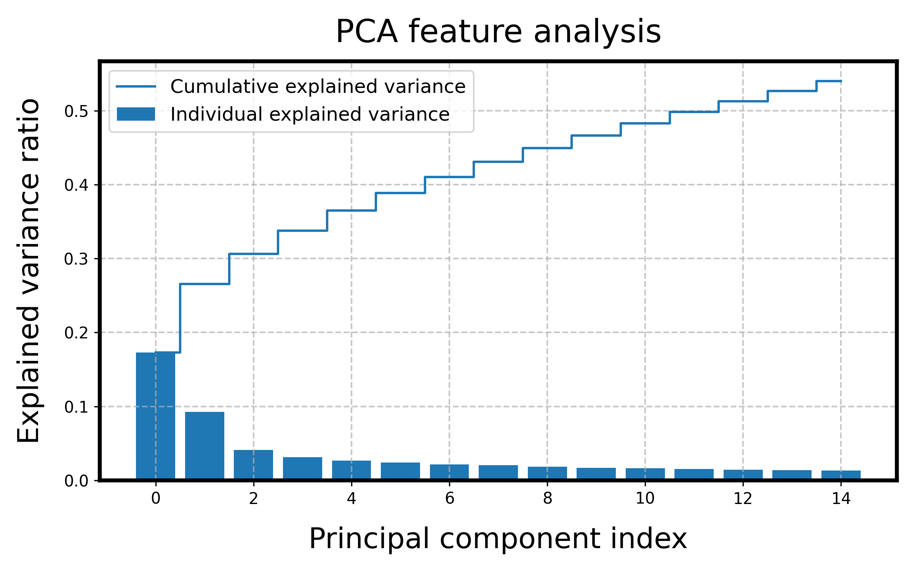
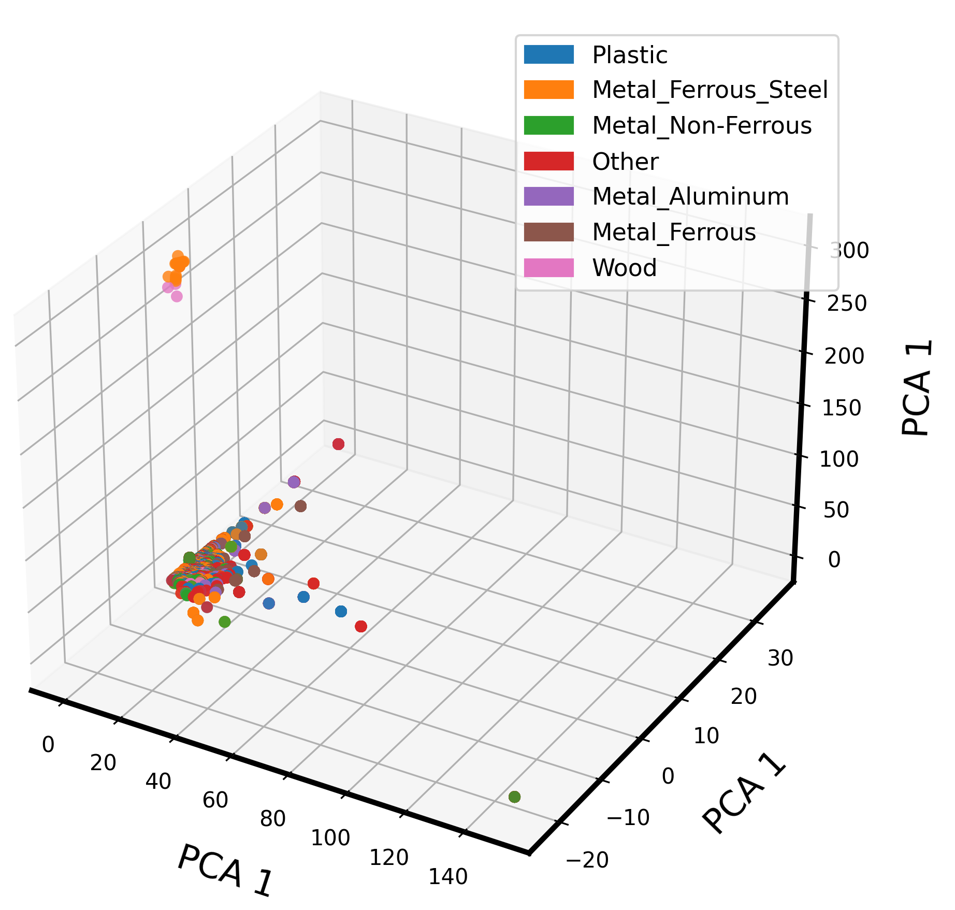
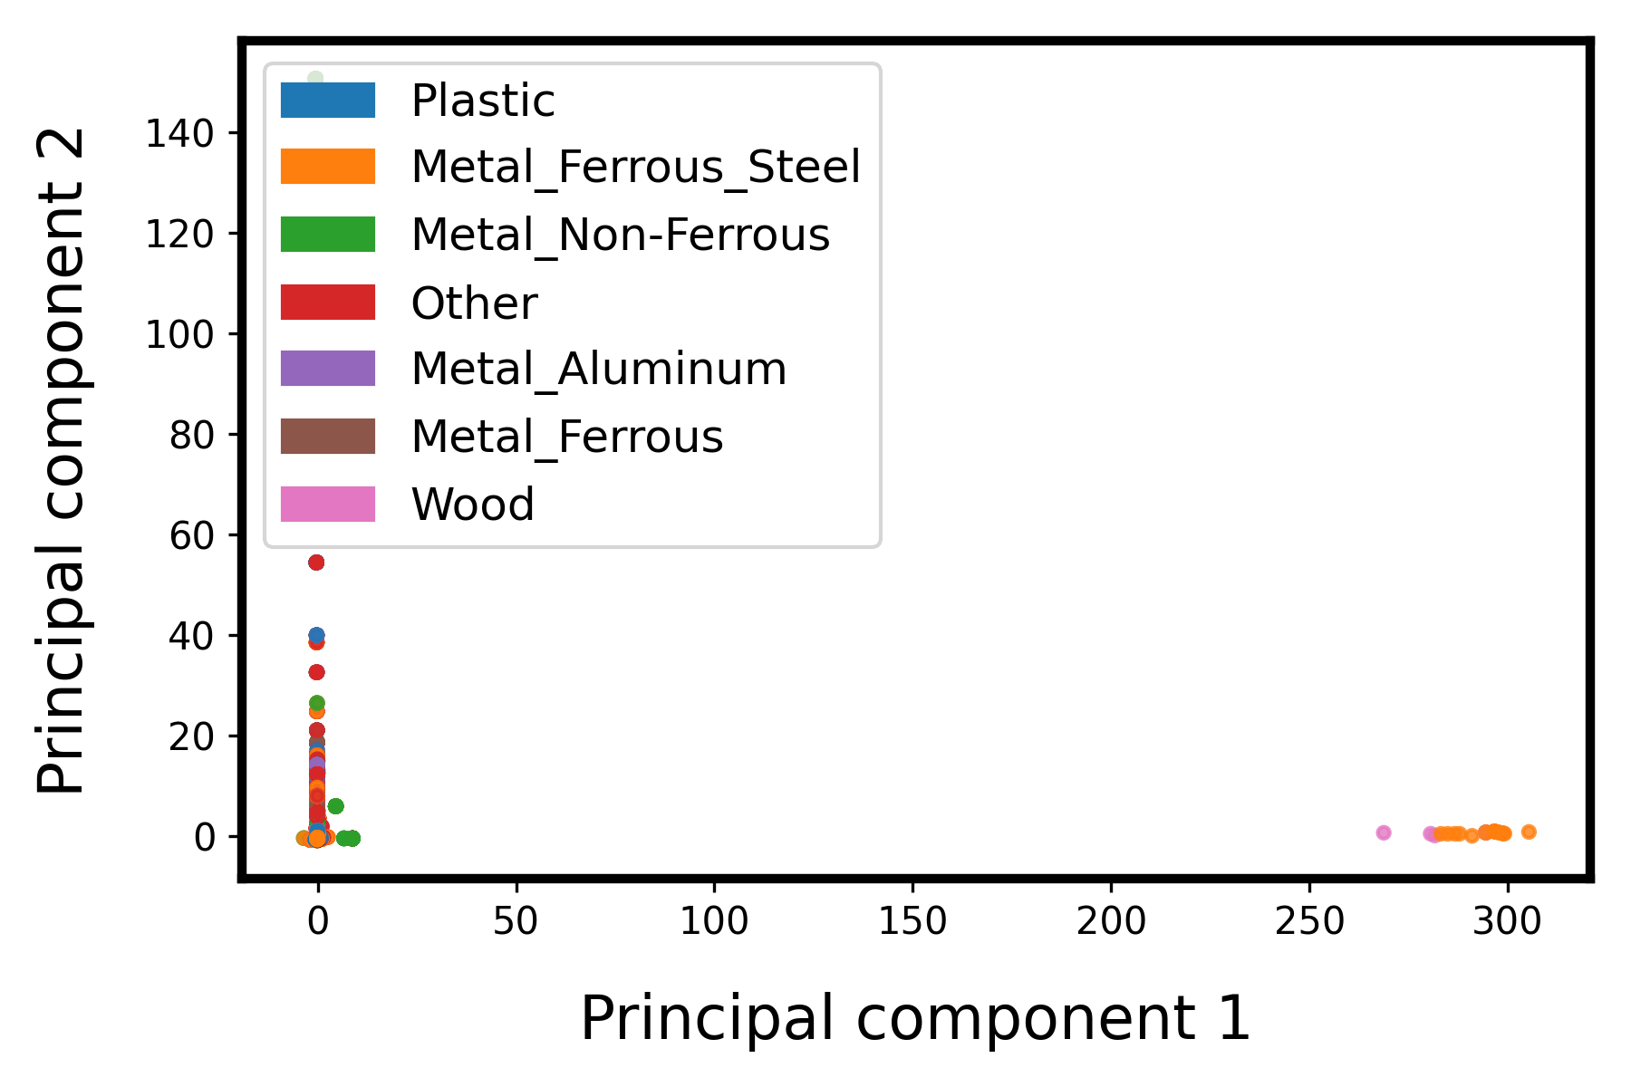
3. Visualization and dimensionality reduction

Slide 23
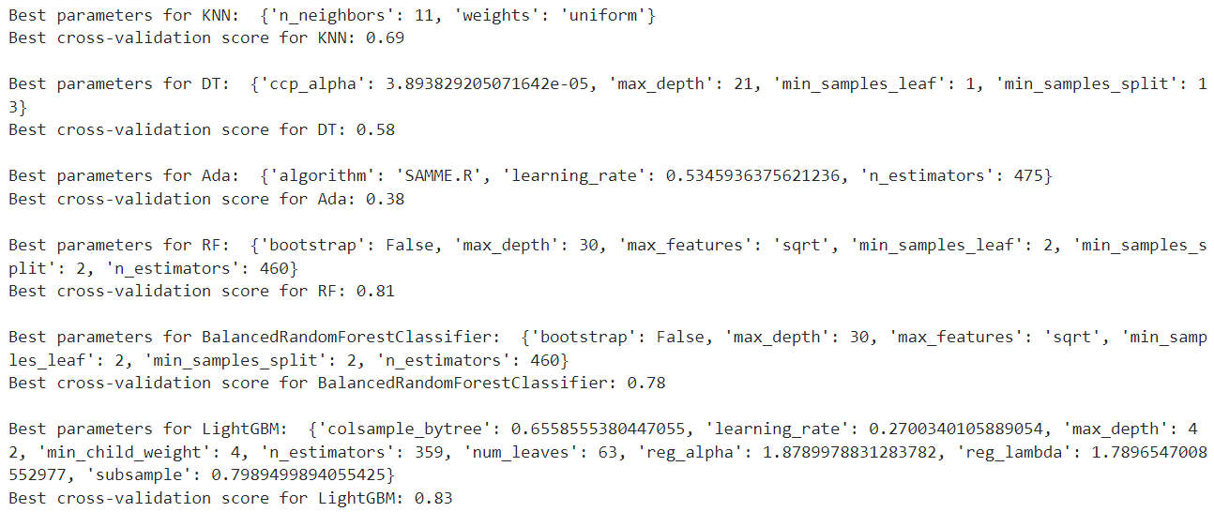
3. ML modelling
General Procedure:
Train-validation split = 8:2
Selected models (7): ["KNN", "DT", "AdaBoost", "RF", "BalancedRandomForest", 'LightGBM', "XGBoost"]
5-fold cross-validation for hyperparameter tuning
Initial tuning with RandomSearchCV
Fine-tuning: GridSearchCV
Best hyperparameter is used to train the model on the training set, and validate on validation set
Ensemble learning: Weighted Voting
The final model with best validation score is used to make inference on the testing set.

Slide 24
3. ML modelling: Regularization and pruning (prevent overfitting)
Hyperparameter tuning:
1. KNN:
- Complexity Control: k - the number of neighbours. A small k can lead to a noisy model (overfitting), while a large k can lead to a too smooth model (underfitting).
- Distance Metric: Euclidean, Manhattan. Weighted KNN, where closer neighbours have a bigger influence, can also be considered.
2. Decision Trees (DT):
- Pruning: setting a limit on the maximum depth, minimum samples at a leaf, or minimum samples to split a node. → prevents the tree from growing too deep, which can lead to overfitting.
- Regularization: The `ccp_alpha` parameter used for Minimal Cost-Complexity Pruning. A higher `ccp_alpha` prunes more of the tree.

Slide 25
3. ML modelling: Regularization and pruning (prevent overfitting)
Hyperparameter tuning:
3. Random Forest (RF):
- Tree Depth and Leaf Samples: control the maximum depth of the trees in the forest or set a minimum number of samples required to be at a leaf node.
- Number of Trees: More trees increase the robustness of the model at the cost of computational efficiency. But after a certain point, adding more trees doesn't improve performance significantly.
- Features per Split: setting the `max_features` parameter to control how many features are considered for each split. This introduces randomness and can help in reducing overfitting.
- Out-of-Bag (OOB) Score: The OOB score can be used as an approximation to the validation error without a separate validation set. If the OOB error is much lower than the test error, it might indicate overfitting.

Slide 26
3. ML modelling: Dealing with imbalanced dataset
Stratified Split: ensures that the train and validation sets have approximately the same percentage of samples of each target class as the complete dataset.
Using class_weight: during the hyperparameter tuning phase (i.e., within RandomizedSearchCV or GridSearchCV) and during final training. This will ensure that during both phases, the classifier is taking into account the imbalances in the class distribution.
Evaluation Metrics during Hyperparameter Tuning: choose F1 score (F1 weighted) instead of accuracy.
"f1_macro": Calculate metrics for each label and find their unweighted mean.
"f1_weighted": Calculate metrics for each label, and find their average weighted by support (the number of true instances for each label).

Slide 27
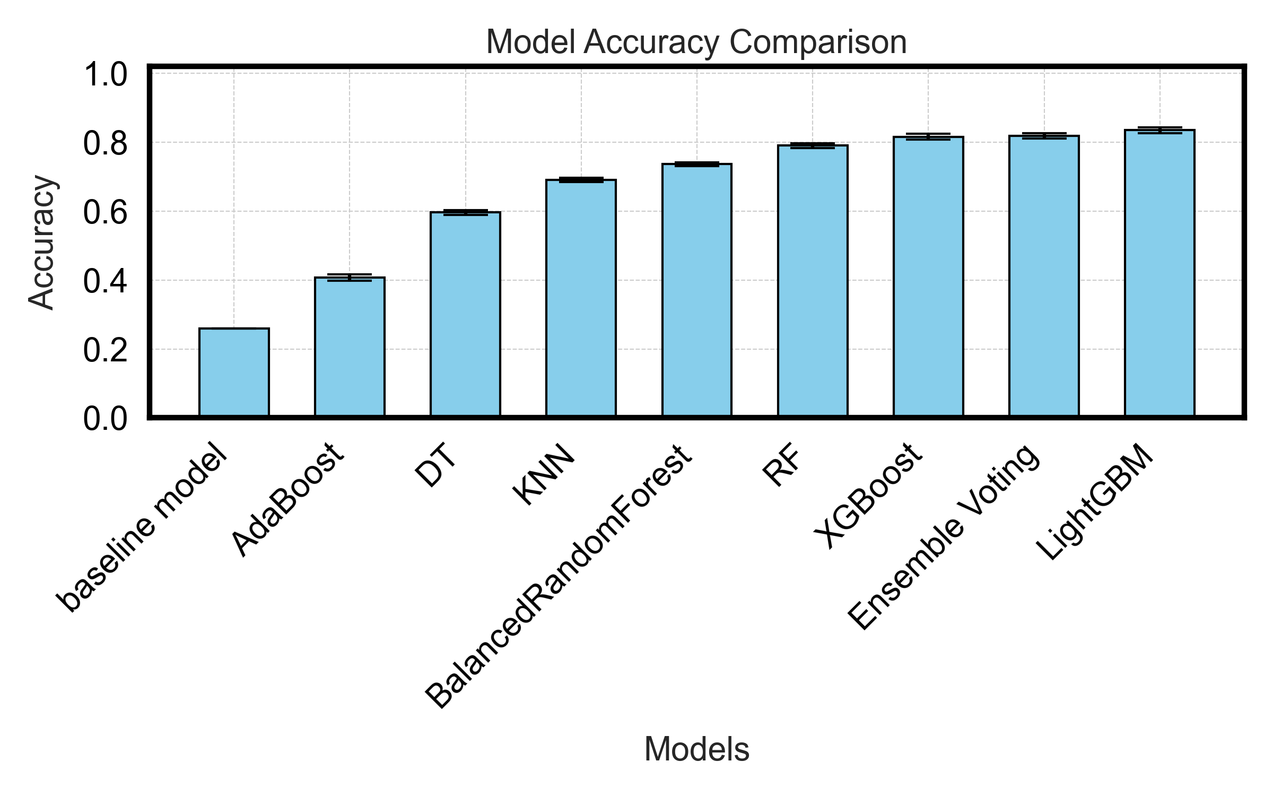
4. Results and Discussions
Best performance on the validation set was achieved by the LightGBM (light gradient-boosting machine) Classifier (~83.4%).
Followed by similar accuracy by RF, XGBoost.
All models with the selected features obtained higher accuracy than the baseline model

Slide 28
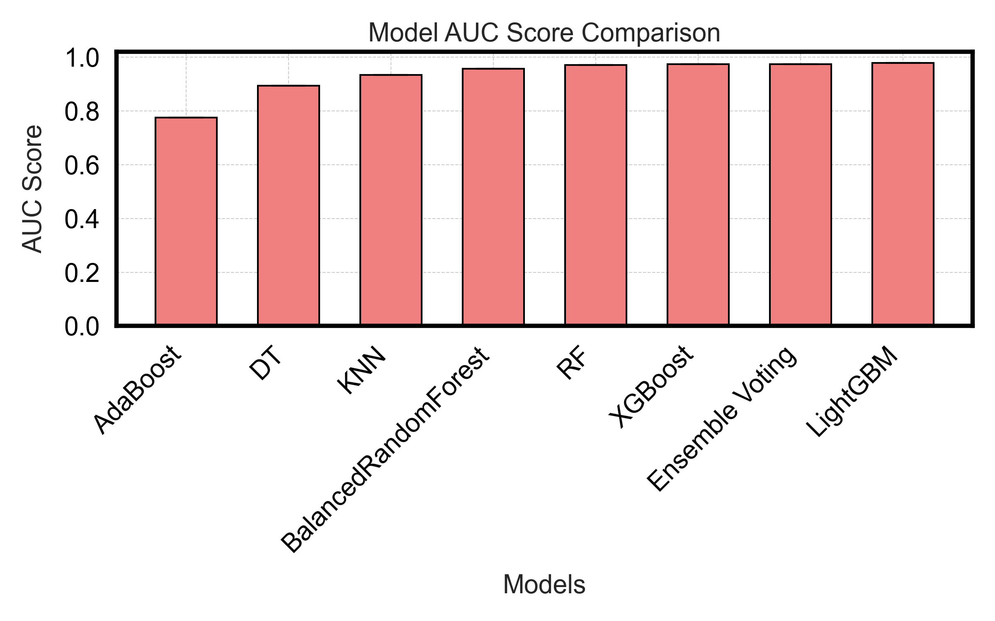
4. Results and Discussions
Reasonably good AUC score

Slide 29
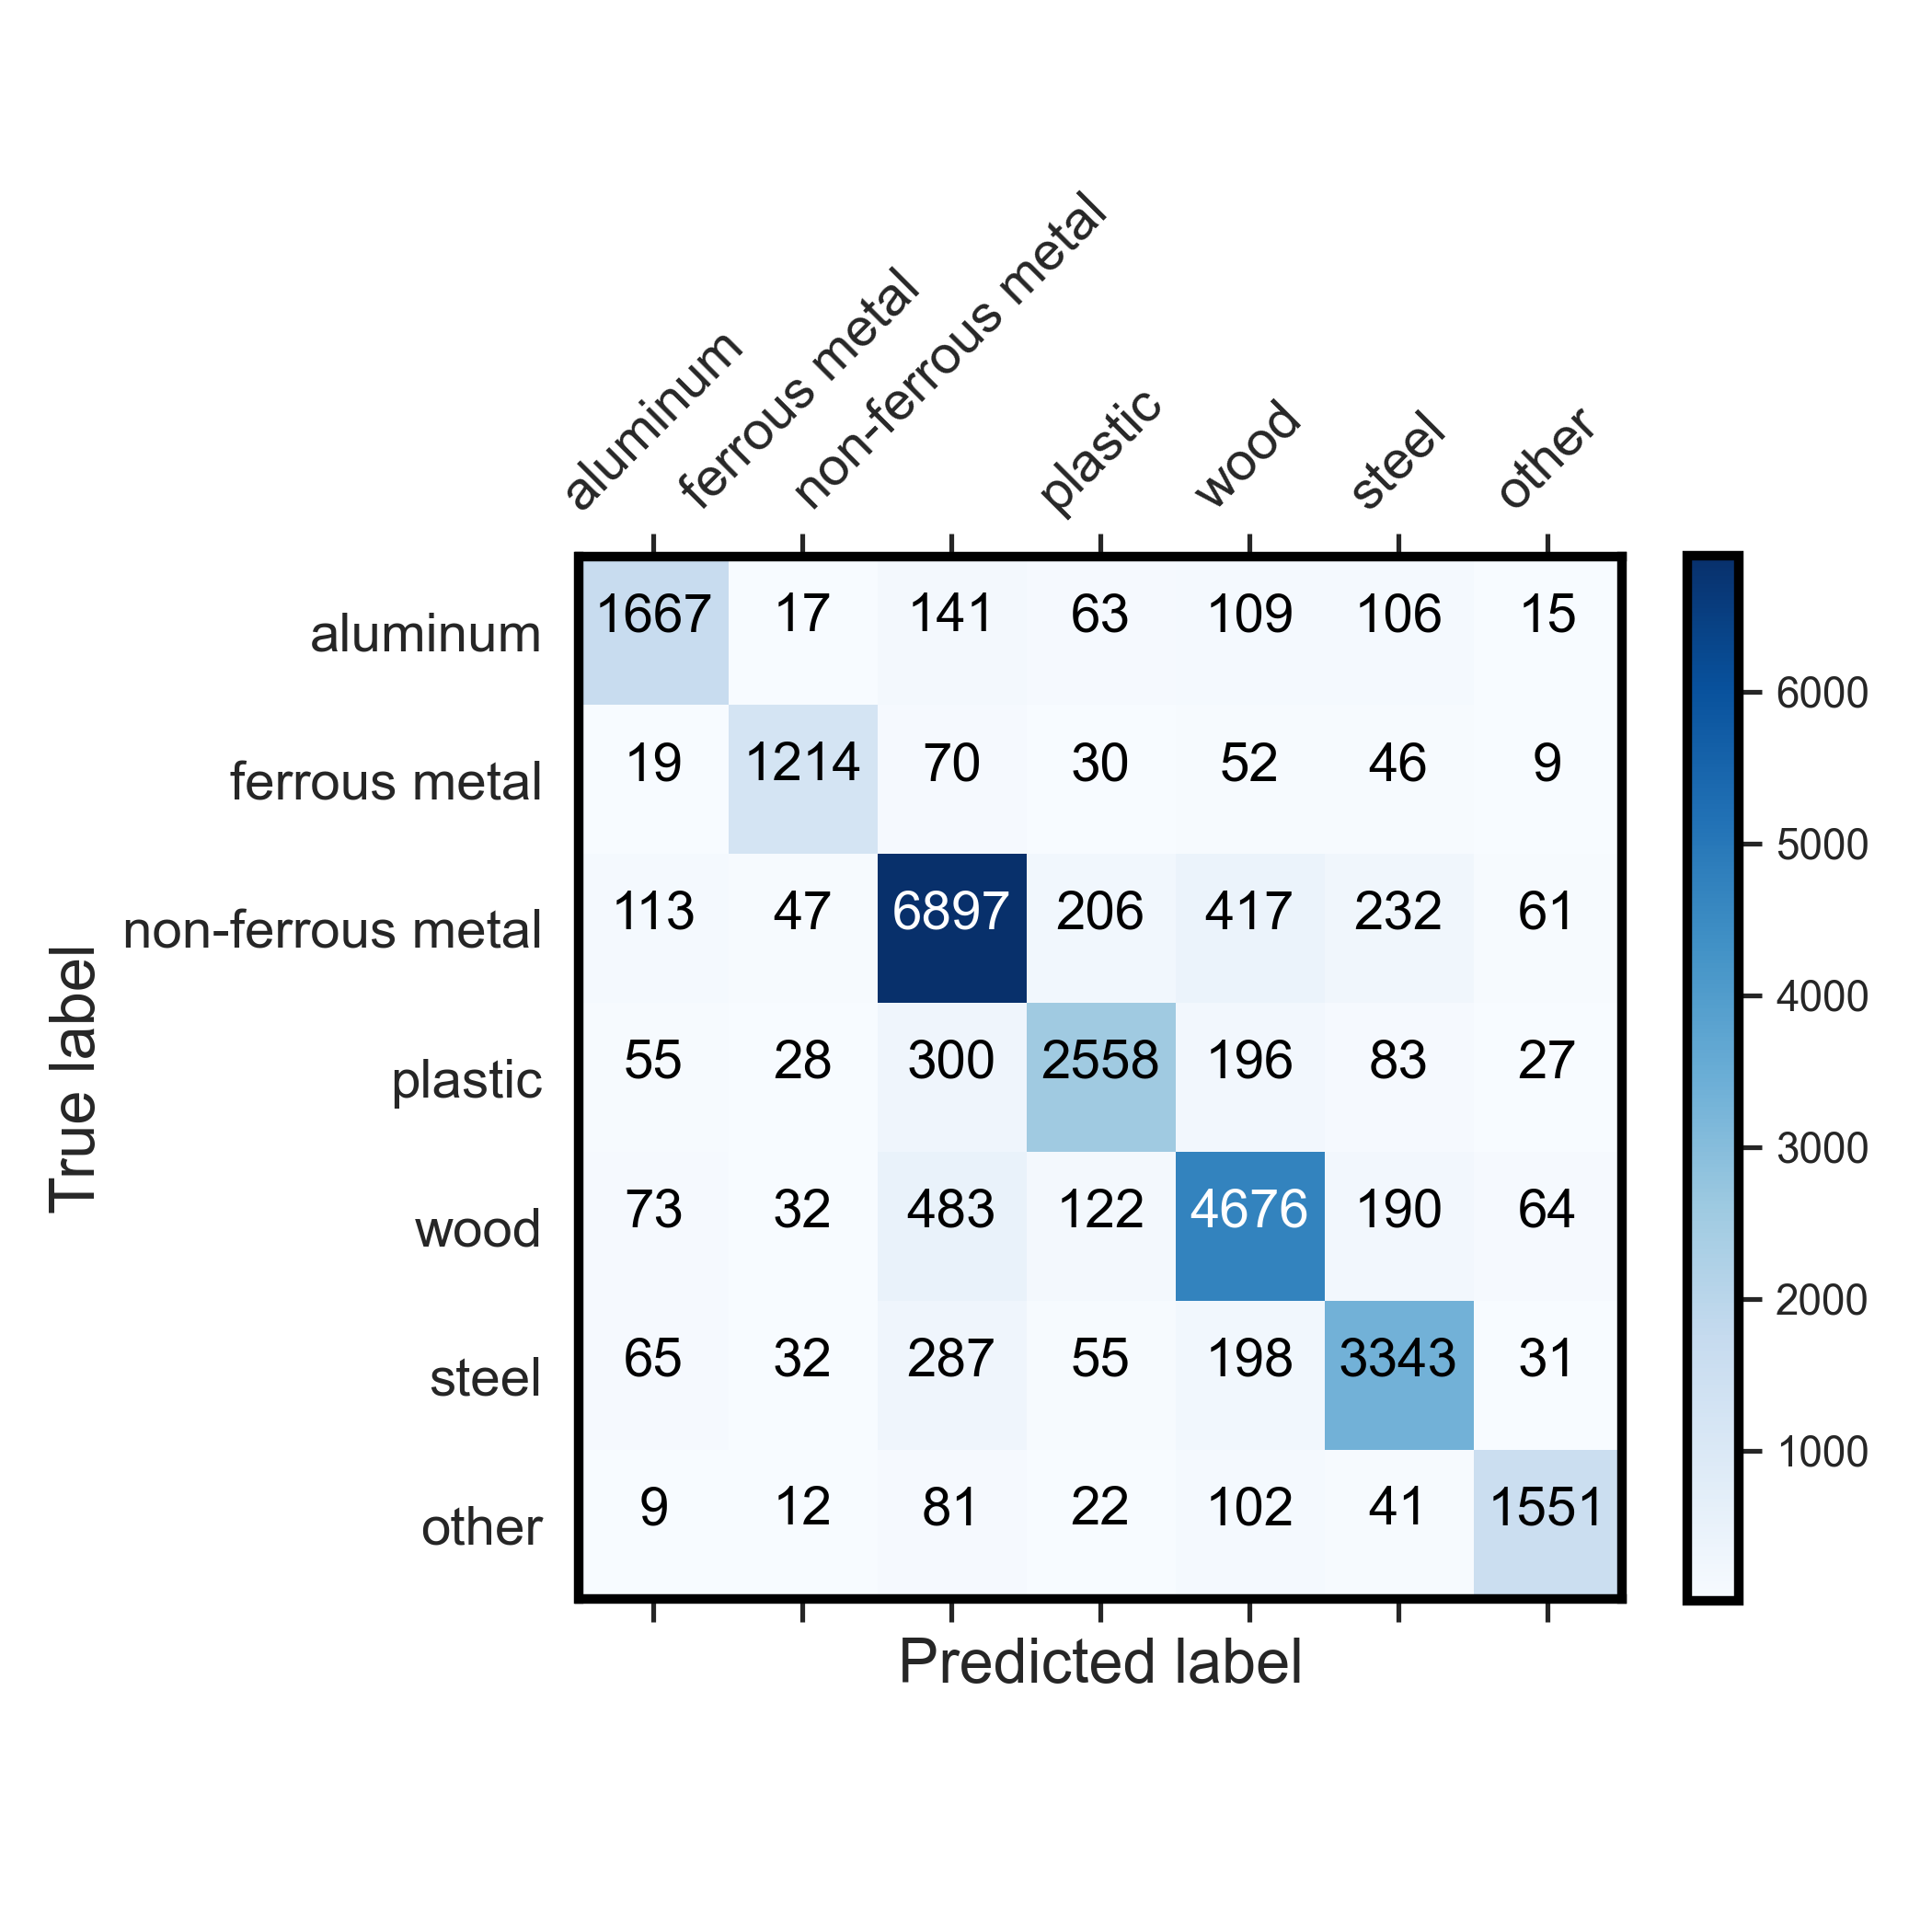
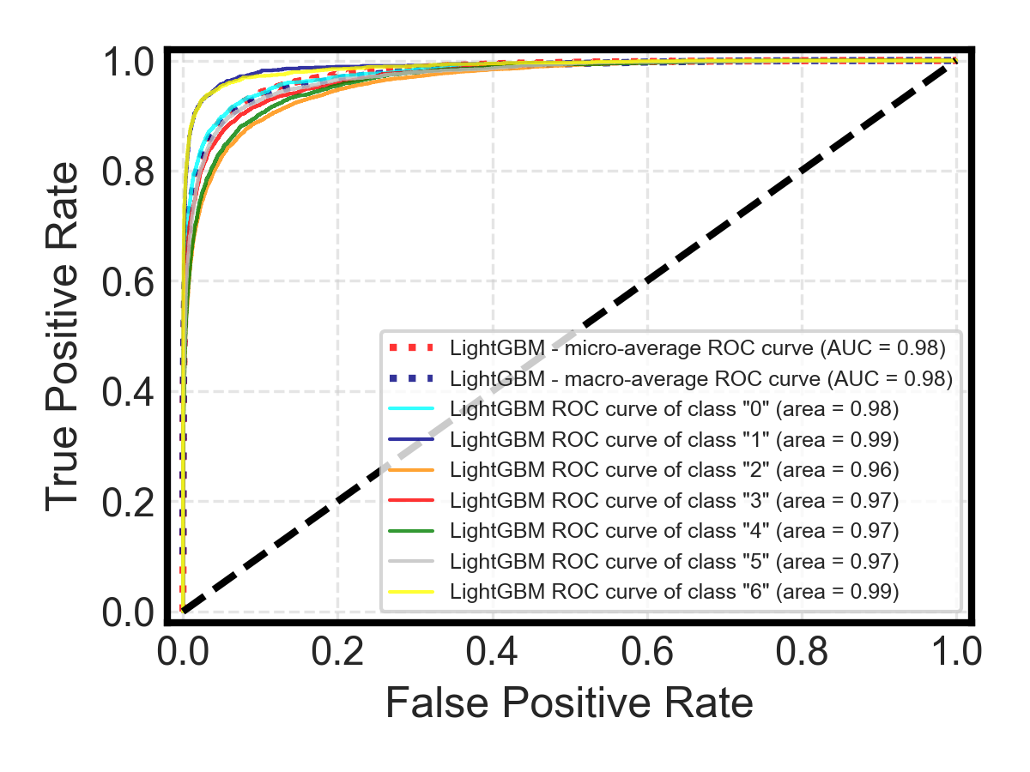
4. Results and Discussions
LightGBM (Best performance) – Validation accuracy : 83%

Slide 30
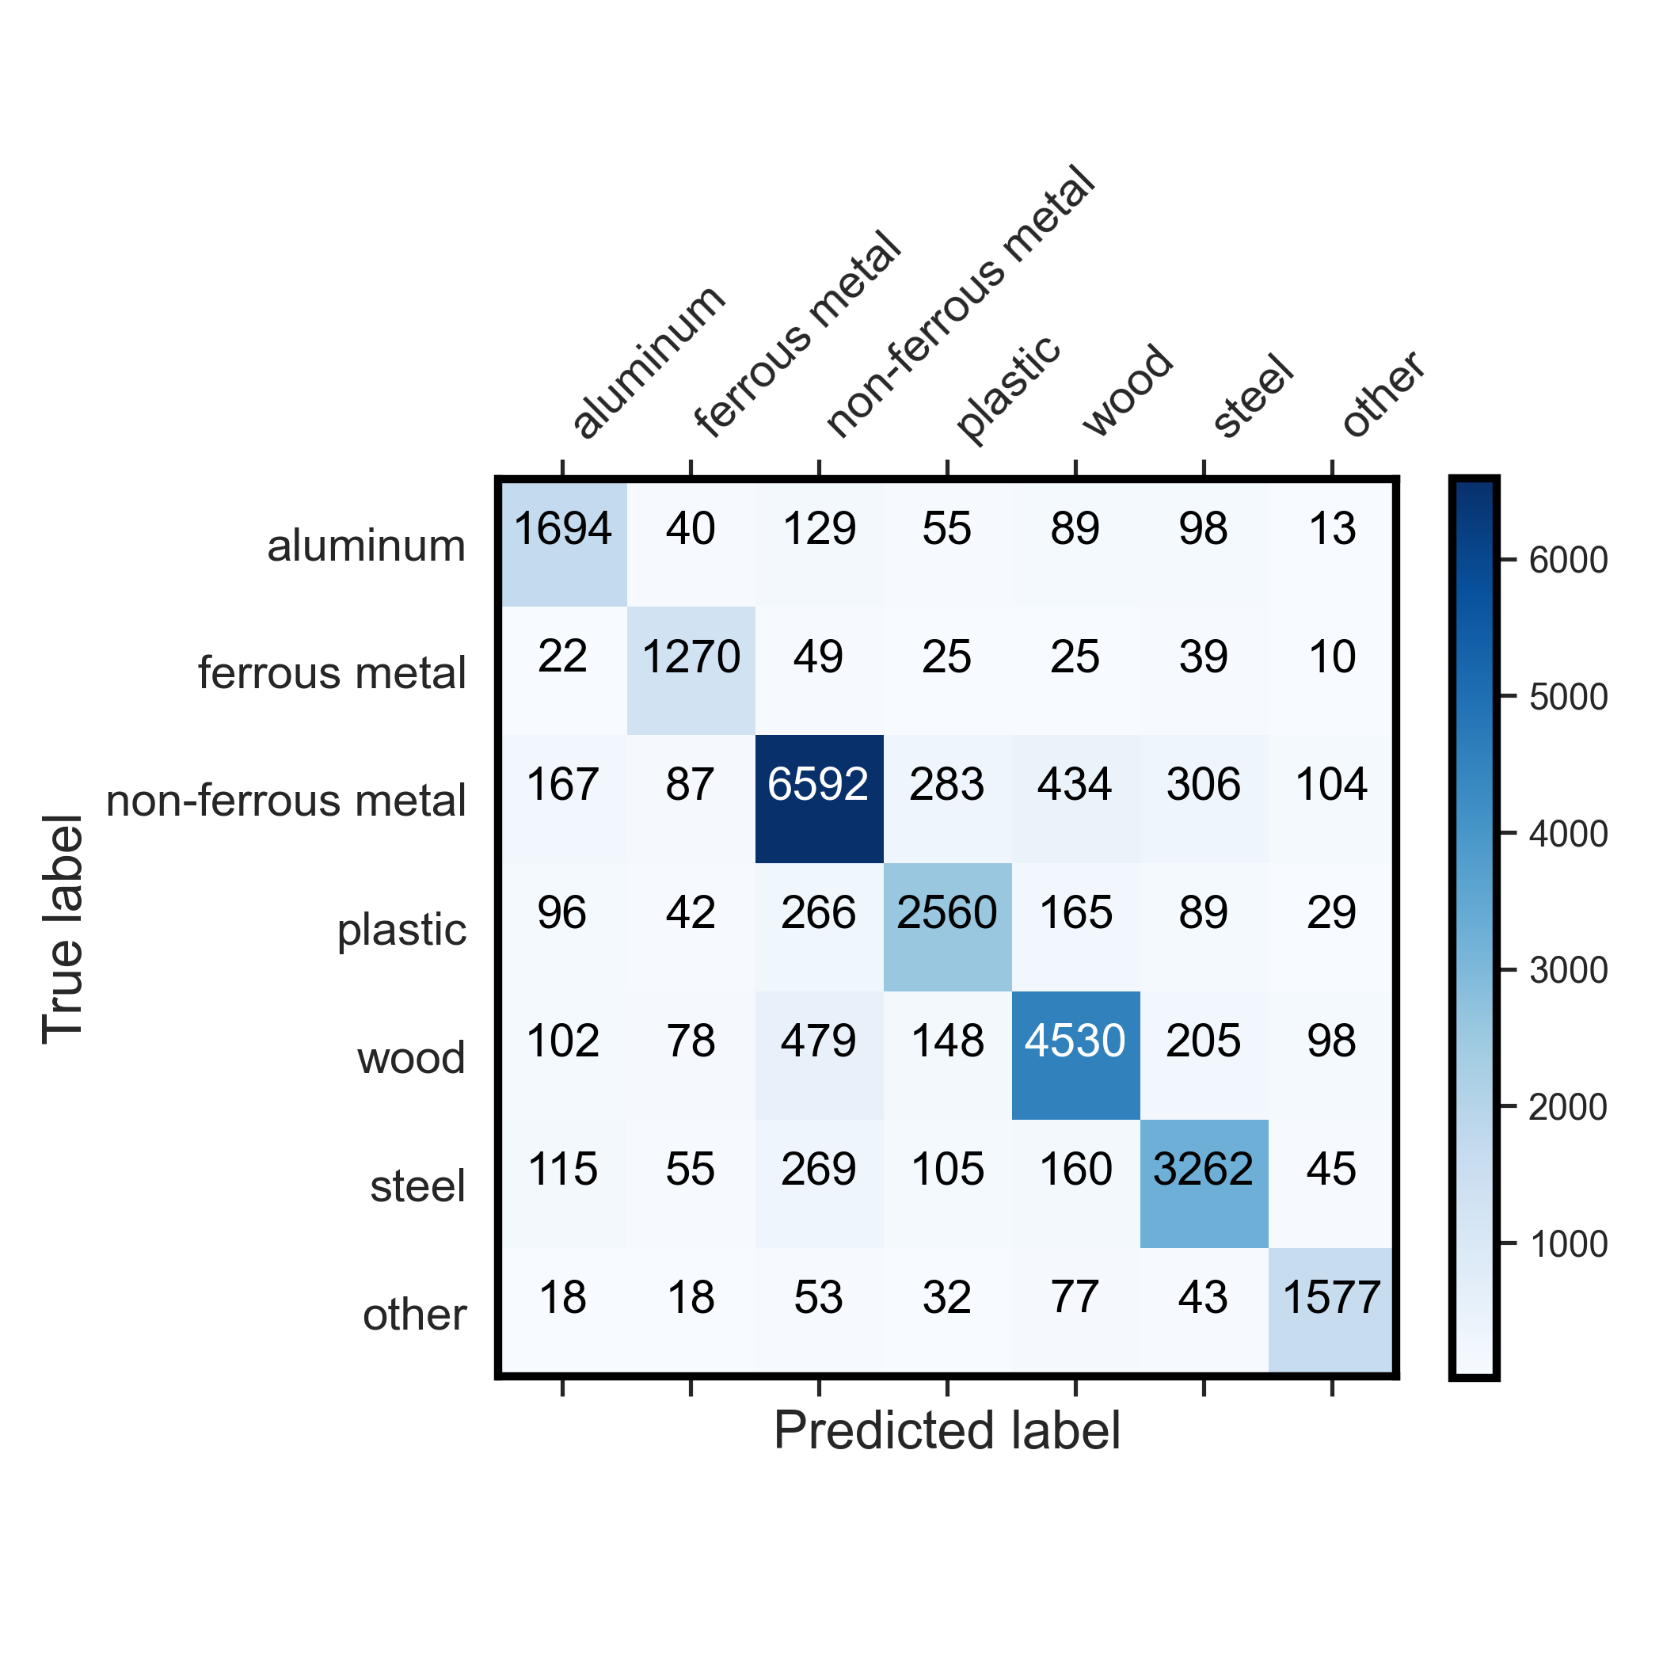
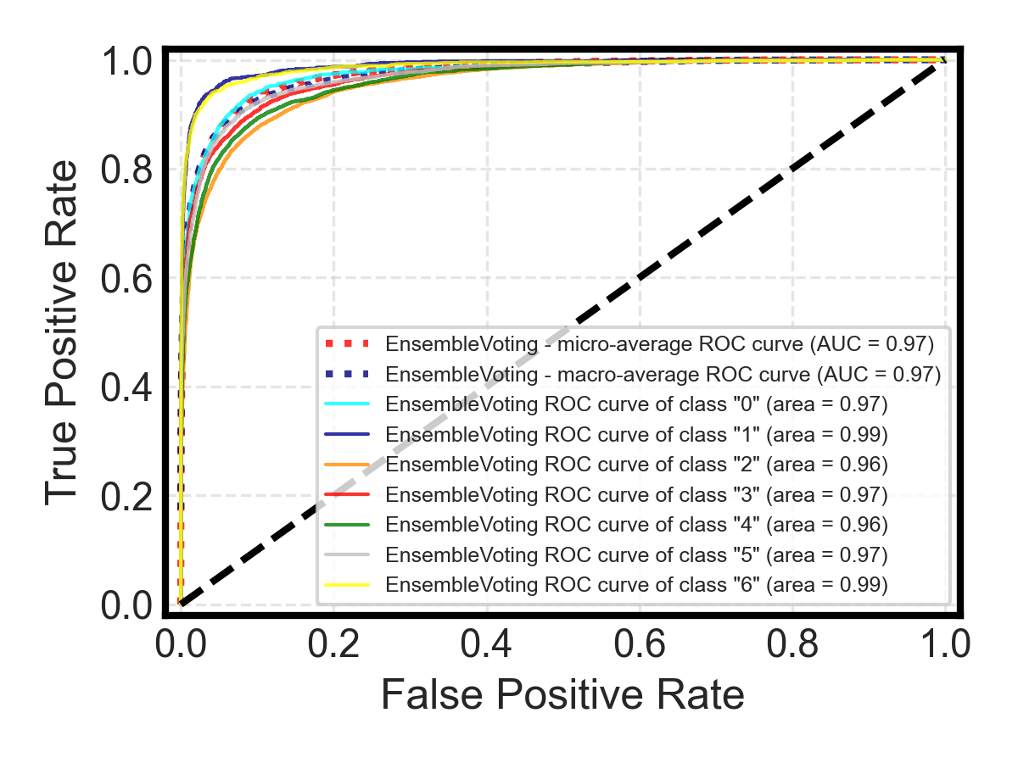
4. Results and Discussions
Ensemble Voting – Validation score: 82%

Slide 31

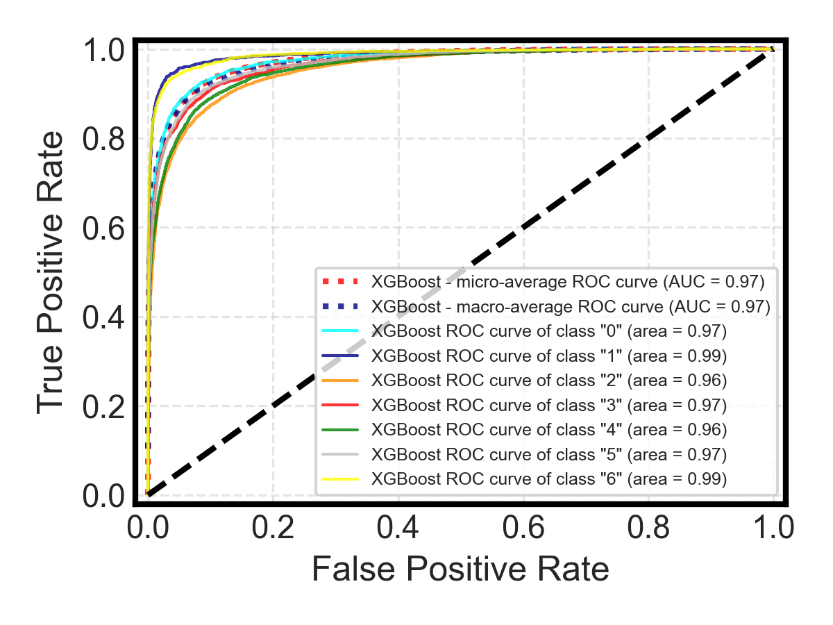
4. Results and Discussions
XGBoosting – Validation score: 80 %

Slide 32
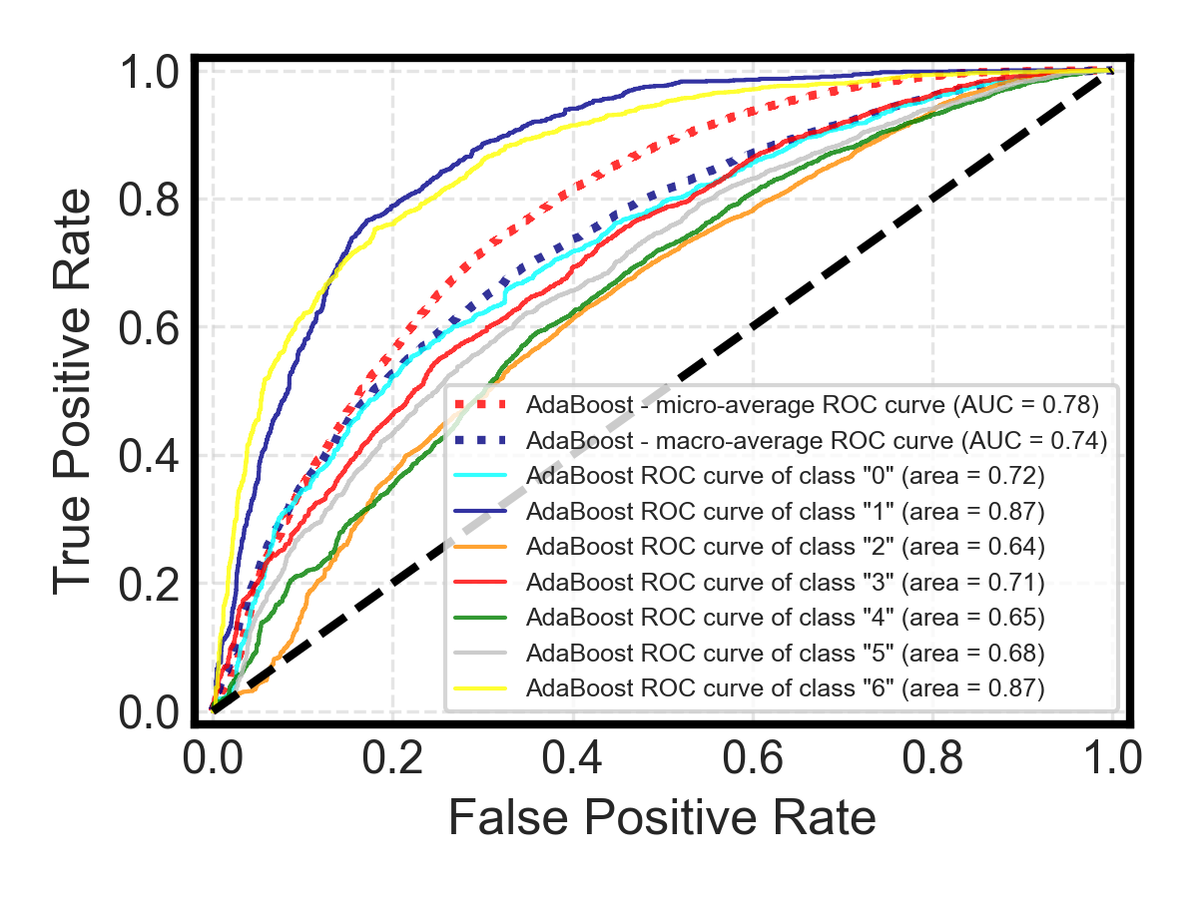
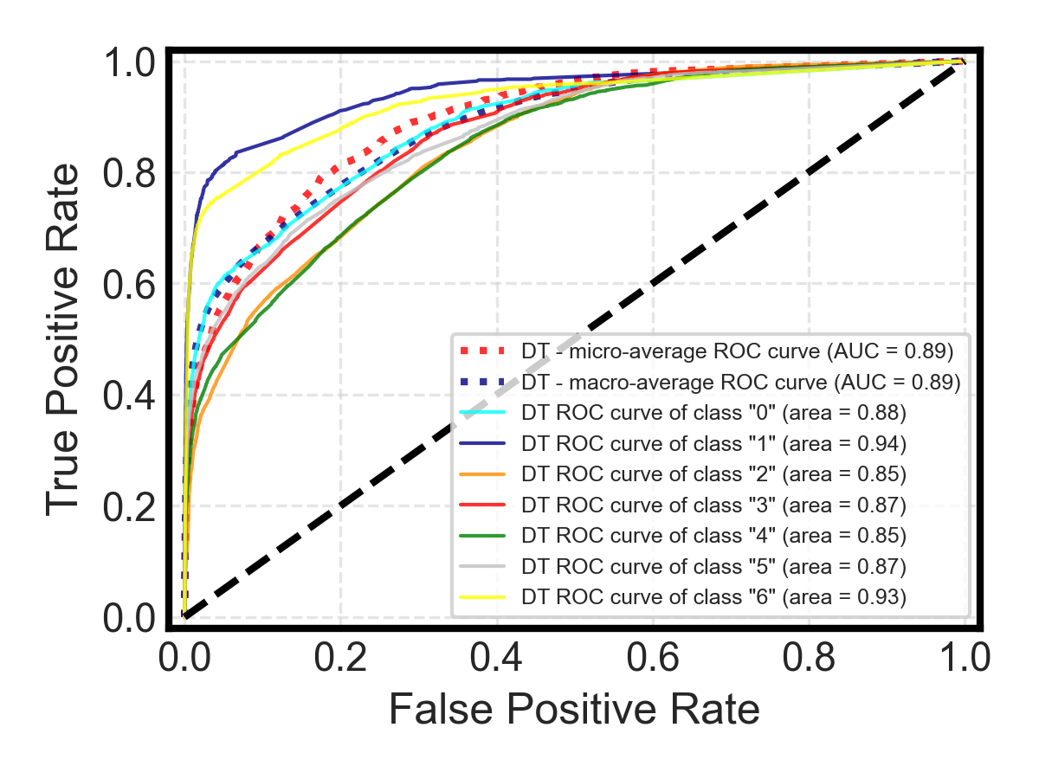
4. Results and Discussions (ROC-AUC curve)
Adaboost – 40%
Decision Tree – Validation score: 59%

Slide 33
4.2. Model confidence or uncertainty estimation
Decision Function / Predict Probability (for Scikit-learn models):
Many classifiers in Scikit-learn have a decision_function or predict_proba method. These can provide measures of confidence in predictions.
predict_proba gives class probabilities similar to the softmax output.
decision_function gives a distance to the decision boundary. The magnitude (absolute value) can be interpreted as confidence.
Model Ensembling:
If you're using an ensemble of models, the variability in predictions from different models can indicate uncertainty. For instance, if all models in the ensemble agree on a prediction, it's likely more reliable than if they're all over the place.
The standard deviation of predictions from ensemble members can be a measure of uncertainty.

Slide 34
3. ML modelling: Enhancing model robustness
Ensemble learning
Feature Jittering
Feature jittering involves adding small Gaussian noise to the features.
Feature Dropout
A simple way to implement feature dropout is to randomly set a portion of the features to zero for each batch during training. This encourages the model to not overly rely on any single feature.

Slide 35
Domain Adaptation:
Adversarial Training: Use techniques like Adversarial Domain Adaptation. These methods aim to learn representations that are invariant to domain shifts by using adversarial training. The idea is to make the feature representations from both domains (e.g., training and test) indistinguishable.
Synthetic Data Generation:
Use techniques like SMOTE (Synthetic Minority Over-sampling Technique) to generate samples that resemble the test set. This works well when you have a good idea of what the test set looks like, especially in terms of class distributions.
Weighted Loss:
If you have an idea of how the distribution of the test set differs from the training set, you can use a weighted loss function during training. For instance, if you know a particular class is underrepresented in the training set but is frequent in the test set, you can assign a higher weight to that class during training.
Ensemble Techniques:
Use ensemble methods that combine predictions from models trained on different subsets of the data or using different architectures. Sometimes, ensemble models can be more robust to distribution shifts.
Regularization:
Even though you validated on a separate set, adding some regularization might still help. Techniques like dropout, L1/L2 regularization, or early stopping can help make your model more robust.

Slide 36
5. Reflection
Key Challenges:
Insufficient time and computational resources
Lack of experience in LLM models
Investigations on hierarchical relationship within the JSON file

Slide 37
Thank you！
Q & A

